Slide 1
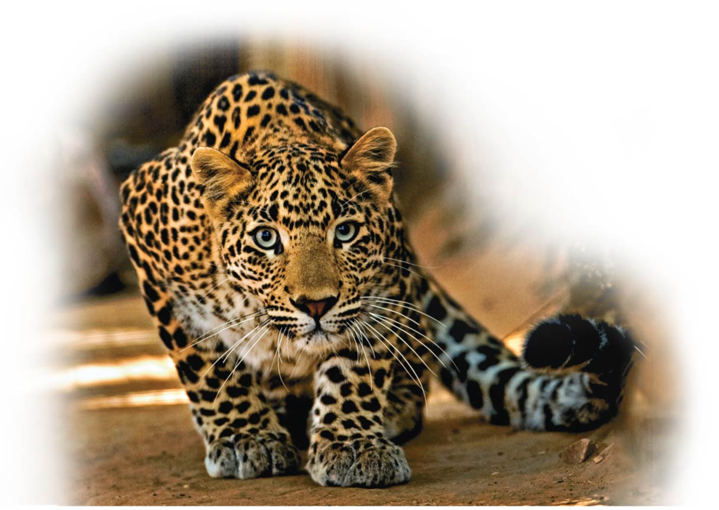
Patterns of Inheritance
Unit 2; Chapter 9

Slide 2
Biology and Society: Our Longest-Running Genetic Experiment
People have selected and mated dogs with preferred traits for more than 15,000 years.
Over thousands of years, such genetic tinkering has led to the incredible variety of body types and behaviors in dogs today.
The biological principles underlying genetics have only recently been understood.
Notes:
2

Slide 3
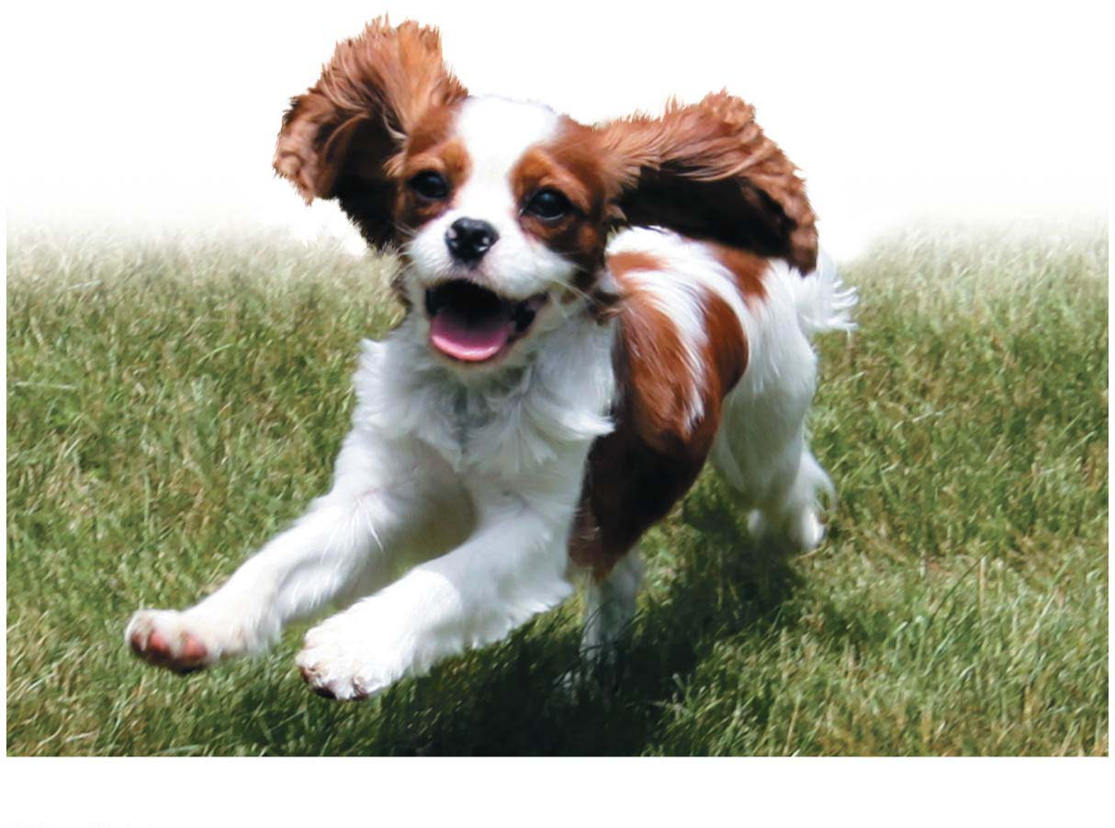
Chapter Thread: Dog Breeding
Notes:
Figure 9.0-2 Dog breeding: breeding a best friend

Slide 4
Genetics and Heredity
Heredity（遗传） is the transmission of traits from one generation to the next.
Genetics is the scientific study of heredity.
Gregor Mendel worked in the 1860s and argued that
parents pass on to their offspring discrete genes (which he termed “heritable factors”),
genes are responsible for inherited traits, and
genes retain their individual identities generation after generation, no matter how they are mixed up or temporarily masked.
Notes:
4

Slide 5
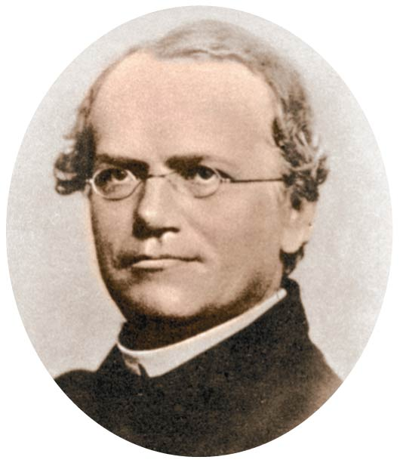
Gregor Mendel
Notes:
Figure 9.1 Gregor Mendel

Slide 6
In an Abbey Garden
Mendel probably chose to study garden peas because they
were easy to grow and
came in many readily distinguishable varieties.
Notes:
6

Slide 7
In an Abbey Garden
A character is a heritable feature that varies among individuals.
A trait is a variant of a character.
Each of the characters Mendel studied occurred in two distinct traits.
Notes:
7

Slide 8
In an Abbey Garden
Perhaps the most important advantage of pea plants as an experimental model was that Mendel could strictly control their reproduction.
The petals（花瓣） of a pea flower almost completely enclose the egg-producing organ (the carpel（心皮）) and the sperm-producing organs (the stamens（雄蕊）).
Consequently, pea plants usually self-fertilize（受精） because sperm-carrying pollen grains released from the stamens land on the tip of the egg-containing carpel of the same flower.
Notes:
8

Slide 9
In an Abbey Garden
When Mendel wanted to fertilize one plant with pollen from a different plant, he pollinated（对…授粉） the plants by hand and was always sure of the parentage of his new plants.
Notes:
9

Slide 10
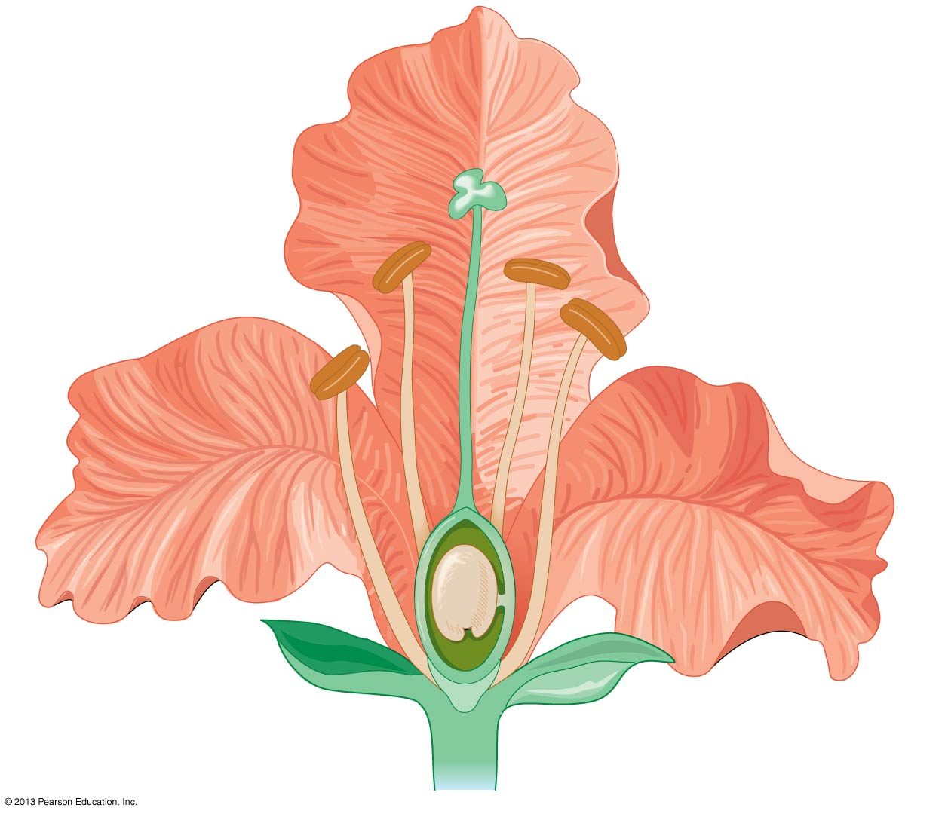

Taken from Chapter 28.
Petal (花瓣)
Stamen
(雄蕊)
Stigma
柱头
Carpel
(雌蕊)
Anther
花粉囊
Style
花柱
Filament
花丝
Ovary
Anther
Ovule
(胚珠)
Sepal (萼片)
Notes:
Figure 28.20 The structure of a flower

Slide 11
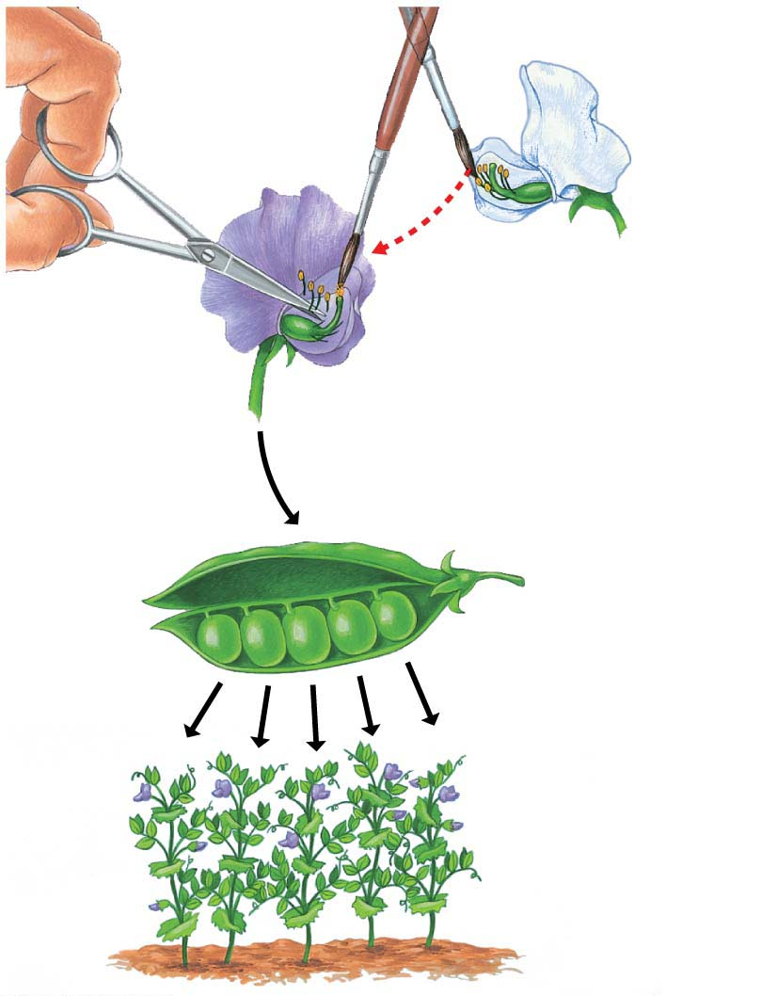
Removed
Stamens（雄蕊）
from purple
flower.
Stamens
Parents
(P)
Transferred pollen（花粉） from
stamens of white flower
to carpel of purple flower.
Carpel
Pollinated carpel
matured into pod.
Planted seeds
from pod（豆荚）.
Offspring
(F₁)
Notes:
Figure 9.3-s3 Mendel’s technique for cross-fertilizing pea plants (step 3)

Slide 12
In an Abbey Garden
Mendel
created purebred varieties of plants and
crossed two different purebred varieties.
Notes:
12

Slide 13
In an Abbey Garden
Hybrids（杂交） are the offspring of two different purebred varieties.
The cross-fertilization itself is referred to as a genetic cross.
The parental plants are the P generation.
Their hybrid offspring are the F₁ generation.
A cross of the F₁ plants forms the F₂ generation.
Notes:
13

Slide 14
Mendel’s Law of Segregation
Mendel performed many experiments in which he tracked the inheritance of characters, such as flower color, that occur as two alternative traits.
The results led him to formulate several hypotheses about inheritance（遗传）.

Slide 15
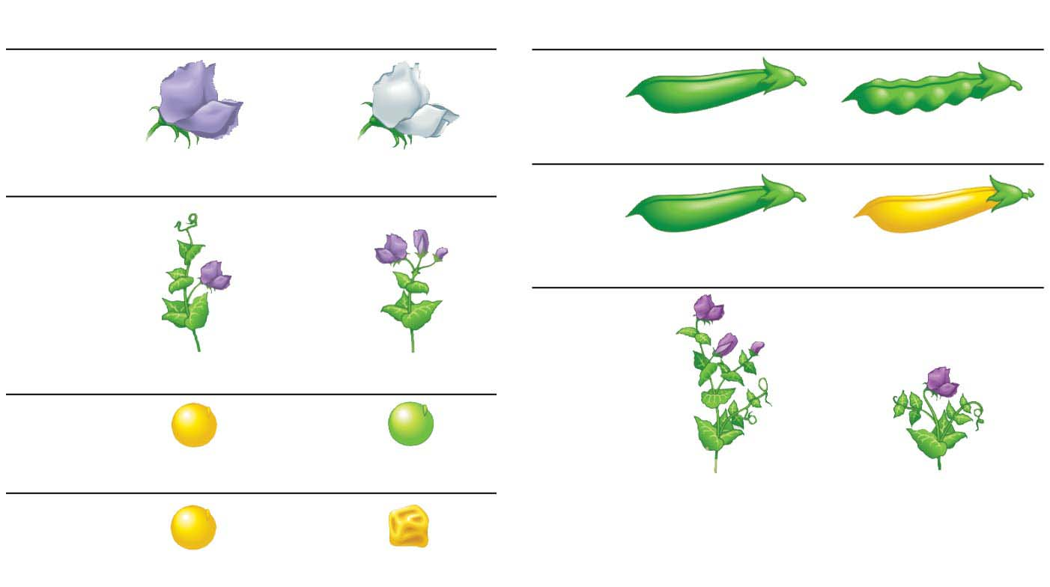
The seven characters of pea plants studied by Mendel
Dominant
（显性）
Recessive
（隐性）
Dominant
Recessive
Flower
color
Pod
shape
Inflated
Constricted
Purple
White
Pod
color
Flower
position
Green
Yellow
Stem
length
Axial
Terminal
Seed
color
Yellow
Green
Tall
Dwarf
Seed
shape
Round
Wrinkled
Notes:
Figure 9.4 The seven characters of pea plants studied by Mendel

Slide 16
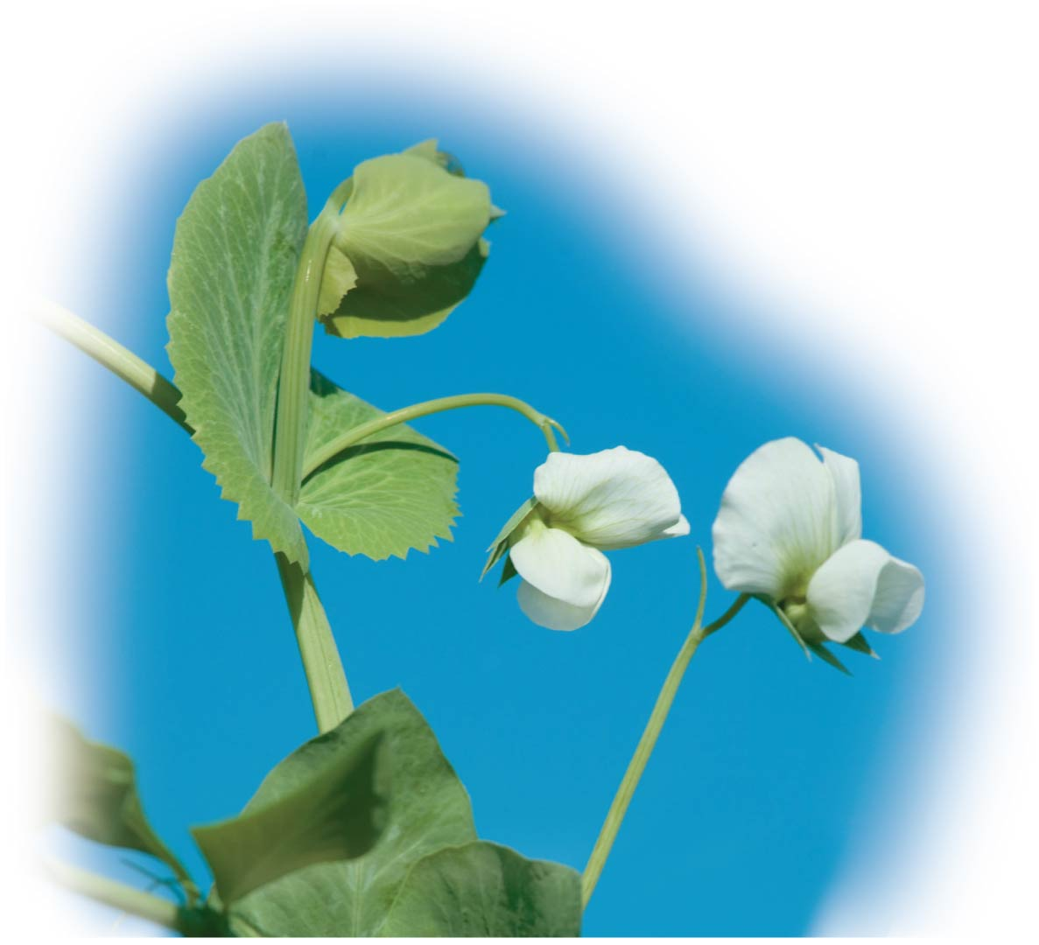
Notes:
Figure 9.4-1 The seven characters of pea plants studied by Mendel (part 1: pea plant photo)

Slide 17
Monohybrid Crosses
Mendel performed a monohybrid cross（单基因杂种杂交） between purebred parent plants that differ in only one character and found that the F₁ plants all had purple flowers.
Was the factor responsible for inheritance of white flowers now lost as a result of the cross?
By mating the F₁ plants with each other, Mendel found the answer to this question to be no.
Mono=one (monohybrid: a type of cross between organisms that differ in only one trait)
Notes:
17

Slide 18
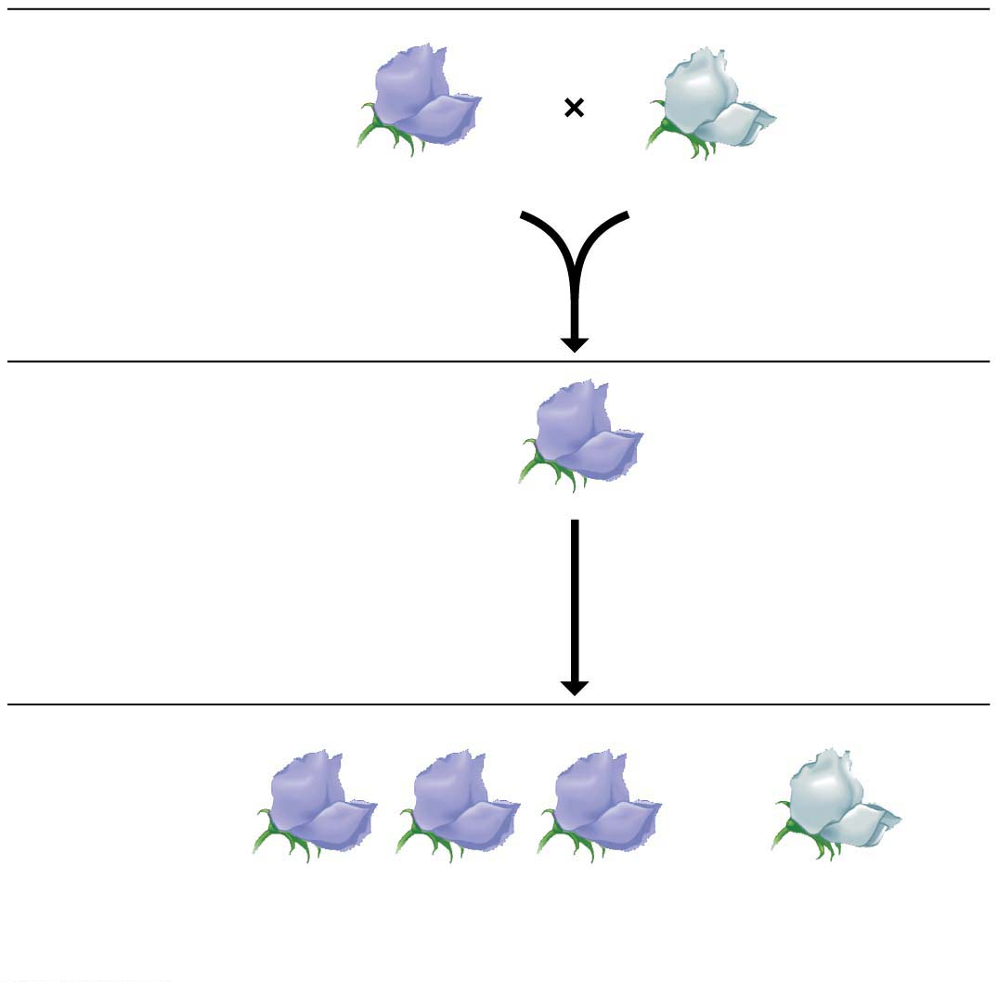
P Generation
(purebred
parents)
Purple
flowers
White
flowers
F₁ Generation
All plants have
purple flowers
Fertilization
among F₁ plants
(F₁ ⋅ F₁)
F₂ Generation
3
4
1
4
of plants
have purple flowers
of plants
have white flowers
Notes:
Figure 9.5-s3 Mendel’s cross tracking one character (flower color) (step 3)

Slide 19
Monohybrid Crosses
Mendel figured out that the gene for white flowers did not disappear in the F₁ plants but was somehow hidden or masked when the purple-flower factor was present.
He also deduced that the F₁ plants must have carried two factors for the flower-color character,
one for purple and
one for white.
Notes:
19

Slide 20
Monohybrid Crosses
From these results and others, Mendel developed four hypotheses:
There are alternative versions of genes that account for variations in inherited characters.
The alternative versions of genes are called alleles（等位基因）.
Notes:
20

Slide 21
Monohybrid Crosses
For each inherited character, an organism inherits two alleles, one from each parent.
An organism that has two identical alleles for a gene is said to be homozygous（纯合子） for that gene.
An organism that has two different alleles for a gene is said to be heterozygous（杂合子） for that gene.
Homo = alike (homozygous: when an organism has the same alleles for a gene)
Hetero = different (heterozygous: when an organism has the different alleles for a gene)
Notes:
21

Slide 22
Monohybrid Crosses
If the two alleles of an inherited pair differ, then one determines the organism’s appearance and is called the dominant allele（显性基因）, and the other has no noticeable effect on the organism’s appearance and is called the recessive allele（隐性基因）.
Geneticists use uppercase italic letters (such as P) to represent dominant alleles and lowercase italic letters (such as p) to represent recessive alleles.
Notes:
22

Slide 23
Monohybrid Crosses
A sperm or egg carries only one allele for each inherited character because the two alleles for a character segregate (separate) from each other during the production of gametes（配子）.
This statement is called the law of segregation（分离定律）.
When sperm and egg unite at fertilization, each contributes its alleles, restoring the paired condition in the offspring.
Next figure illustrates Mendel’s law of segregation, which explains the inheritance pattern shown in the earlier figure.
Notes:
23

Slide 24
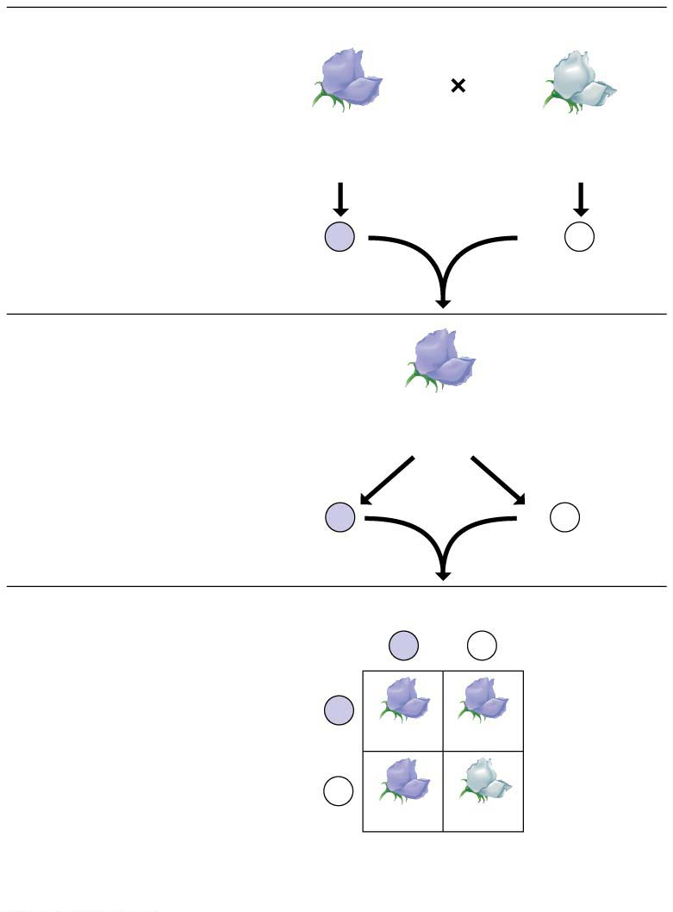
The law of segregation
P Generation
Genetic makeup (alleles)
Purple flowers
White flowers
Alleles carried
by parents
PP
pp
Gametes
All
P
All
p
F₁ Generation
(hybrids)
Purple flowers
Alleles
segregate
Gametes
All
Pp
1
2
P
1
2
p
F₂ Generation
(hybrids)
Sperm from F₁ plant
P
p
P
Eggs from
F₁ plant
PP
Pp
p
Pp
pp
Phenotypic ratio（表型比值）
3 purple:1 white
Genotypic ratio（基因型比值）
1 PP:2 Pp:1 pp
Notes:
Figure 9.6 The law of segregation

Slide 25
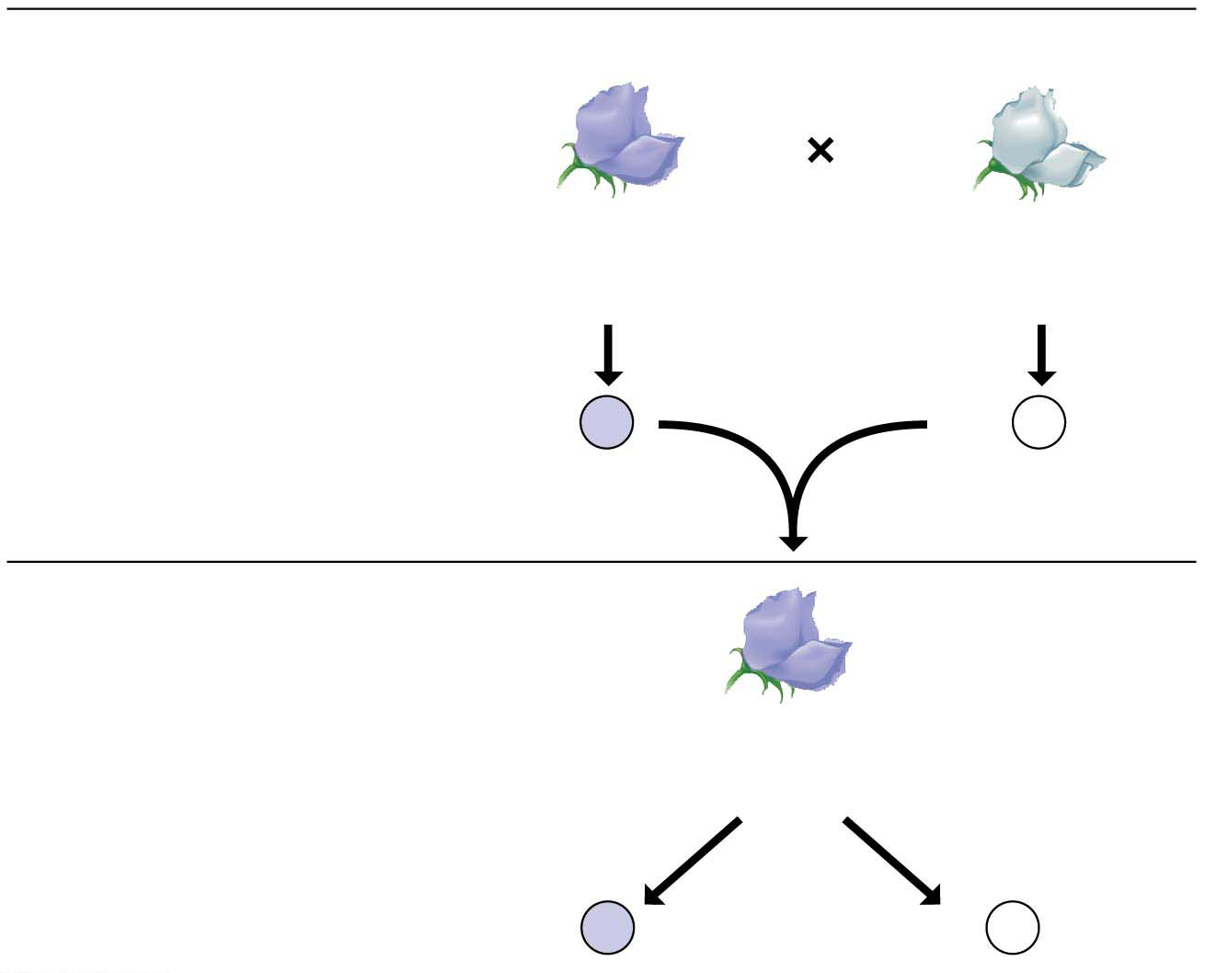
P Generation
Genetic makeup (alleles)
Purple flowers
White flowers
Alleles carried
by parents
PP
pp
Gametes
All
P
All
p
F₁ Generation
(hybrids)
Purple flowers
Alleles
segregate
Gametes
All
Pp
1
2
P
1
2
p
Notes:
Figure 9.6-1 The law of segregation (part 1: P generation and F₁ generation)

Slide 26
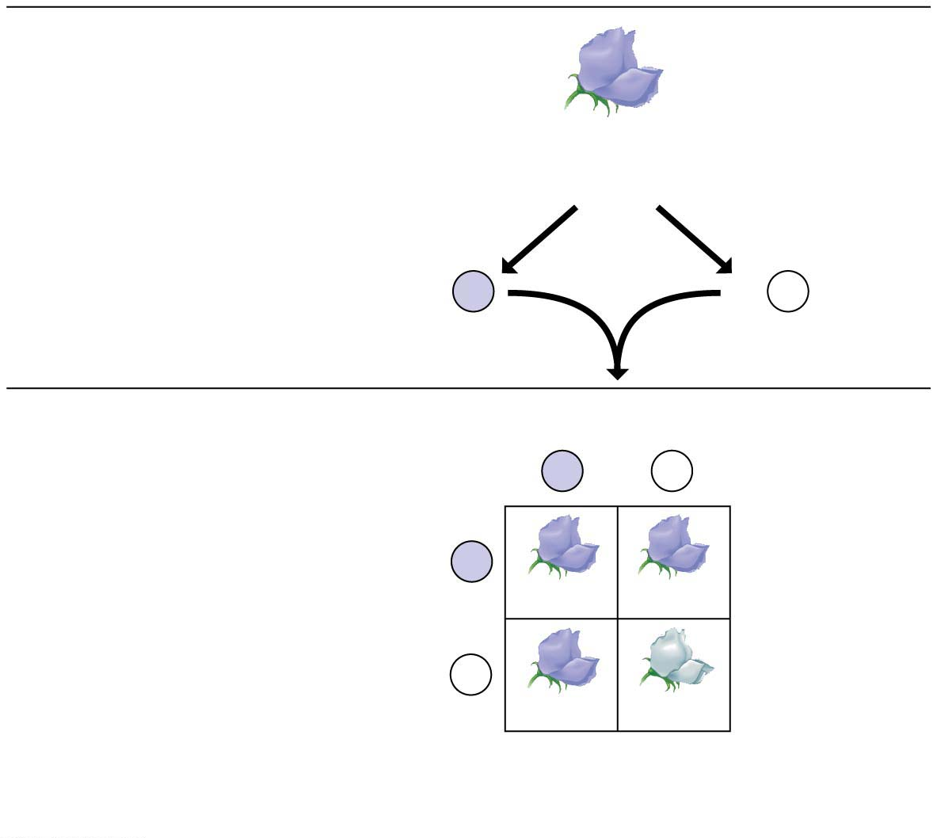
F₁ Generation
(hybrids)
Purple flowers
Alleles
segregate
Gametes
All
Pp
1
2
P
1
2
p
F₂ Generation
(hybrids)
Sperm from F₁ plant
P
p
P
Eggs from
F₁ plant
PP
Pp
p
Pp
pp
Phenotypic ratio
3 purple:1 white
Genotypic ratio
1 PP:2 Pp:1 pp
Notes:
Figure 9.6-2 The law of segregation (part 2: F₂ generation)

Slide 27
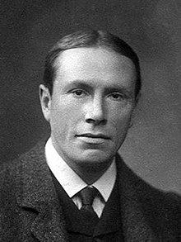
Monohybrid Crosses
A Punnett square highlights
the four possible combinations of gametes and
the resulting four possible offspring in the F₂ generation.
Each square represents an equally probable product of fertilization.
Reginald C. Punnett
British geneticist, who devised this diagram to predict the probability of possible genotypes of offspring.
Notes:
27

Slide 28
Monohybrid Crosses
Geneticists distinguish between an organism’s
physical appearance, its phenotype, and
genetic makeup, its genotype.
Pheno = appearance (phenotype: an organism’s physical traits)
Geno = offspring (genotype: an organism’s genetic makeup)
Notes:
28

Slide 29
Monohybrid Crosses
Mendel found that each of the seven characters he studied had the same inheritance pattern: A parental trait disappeared in the F₁ generation, only to reappear in one-fourth of the F₂ offspring.
The underlying mechanism is explained by Mendel’s law of segregation:
Pairs of alleles segregate during gamete（配子） formation;
the fusion of gametes at fertilization creates allele pairs again.
Notes:
29

Slide 30
Genetic Alleles and Homologous Chromosomes
The diagram in next figure shows a pair of homologous chromosomes（同源染色体）—chromosomes that carry alleles of the same genes.
A gene locus（基因位点） is a specific location of a gene along a chromosome.
Alleles (alternative versions) of a gene reside at the same locus on homologous chromosomes.
However, the two chromosomes may bear either identical alleles or different ones at any one locus.
Notes:
30

Slide 31
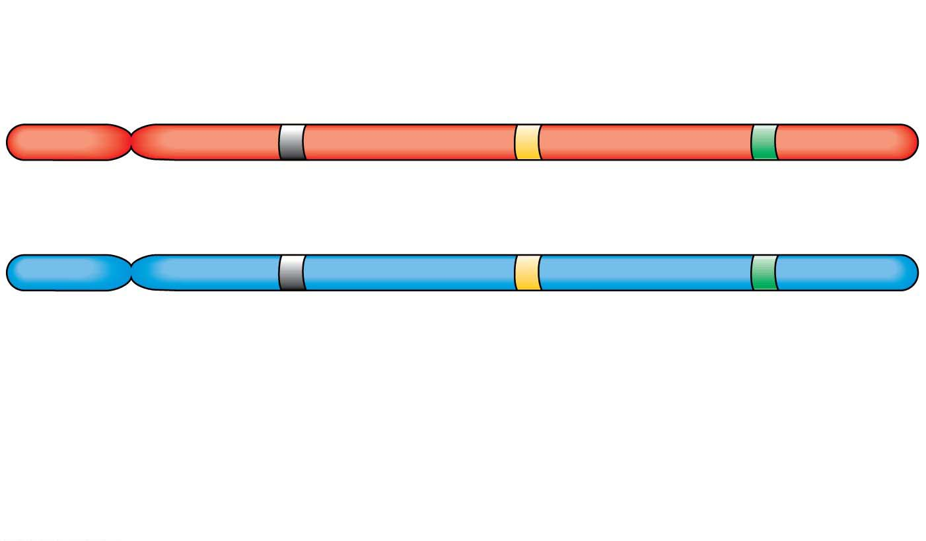
The Relationship between Alleles and Homologous Chromosomes
Homologous
chromosomes
Gene loci
Dominant
allele
P
a
B
P
a
b
Recessive
allele
Genotype:
PP
aa
Bb
Homozygous
for the
dominant allele
Homozygous
for the
recessive allele
Heterozygous
with one dominant
and one recessive
allele
Notes:
Figure 9.7 The relationship between alleles and homologous chromosomes

Slide 32
Mendel’s Law of Independent Assortment
A dihybrid cross（双因子杂种杂交） is the mating of parental varieties differing in two characters.
What would result from a dihybrid cross?
Notes:
32

Slide 33
Mendel’s Law of Independent Assortment
If the genes for the two characters were inherited together, then
the F₁ hybrids would produce only the same two kinds of gametes that they received from their parents, and
the F₂ generation would show a 3:1 phenotypic ratio.
Notes:
33

Slide 34
Mendel’s Law of Independent Assortment
If, however, the two seed characters sorted independently, then
the F₁ generation would produce four gamete genotypes (RY, rY, Ry, and ry) in equal quantities, and
the F₂ generation would have nine different genotypes producing four different phenotypes in a ratio of 9:3:3:1.
Notes:
34

Slide 35
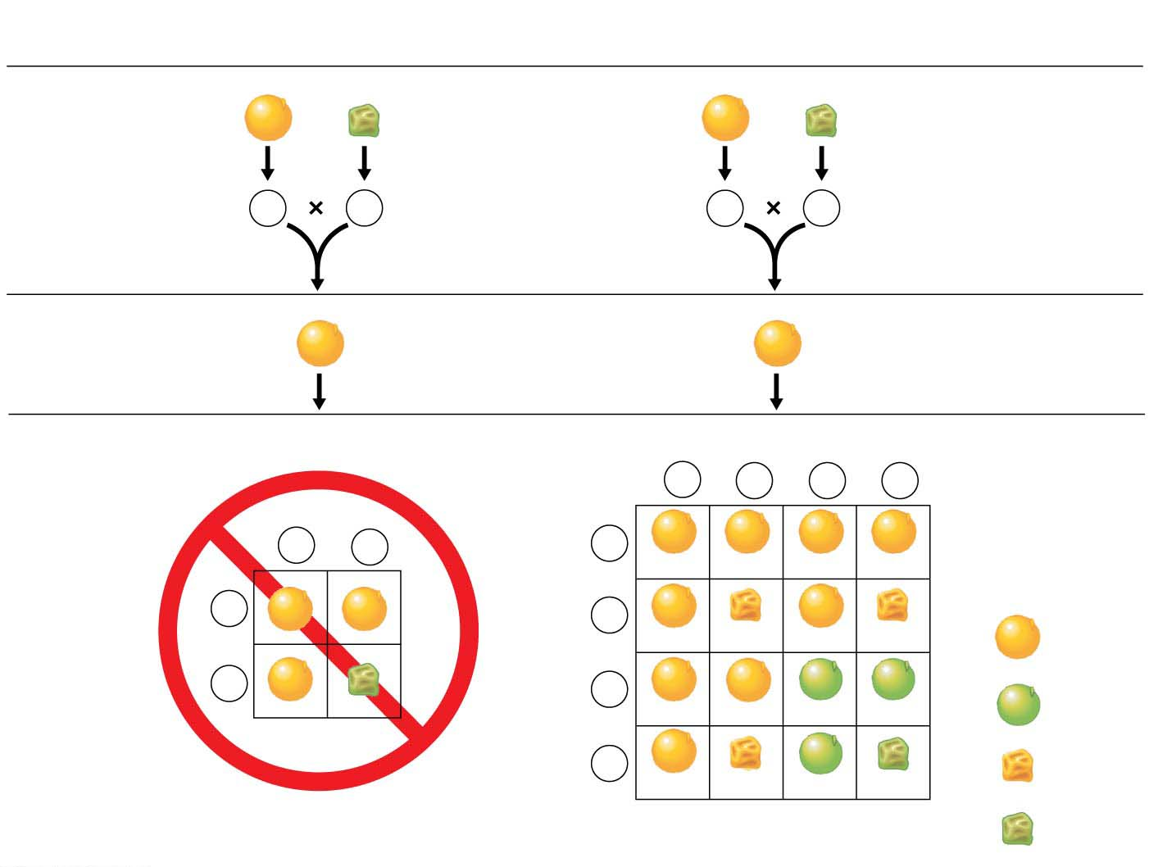
(a) Hypothesis:
Dependent assortment
(b) Hypothesis:
Independent assortment
P Generation
RRYY
rryy
RRYY
rryy
Gametes
RY
ry
Gametes
RY
ry
F₁ Generation
RrYy
RrYy
F₂ Generation
Sperm
1
4
RY
1
4
rY
1
4
Ry
1
4
ry
Sperm
1
2
RY
1
2
ry
1
4
RY
RRYY
RrYY
RRYy
RrYy
1
2
RY
1
4
rY
Eggs
RrYY
RrYy
9
16
Yellow
round
Eggs
rrYY
rrYy
1
2
ry
1
4
Ry
3
16
Green
round
RRYy
RrYy
RRyy
Rryy
1
4
ry
3
16
Yellow
wrinkled
RrYy
rrYy
Rryy
rryy
Predicted results
(not actually seen)
Actual results
(support hypothesis)
1
16
Green
wrinkled
Notes:
Figure 9.8 Testing alternative hypotheses for gene assortment in a dihybrid cross

Slide 36
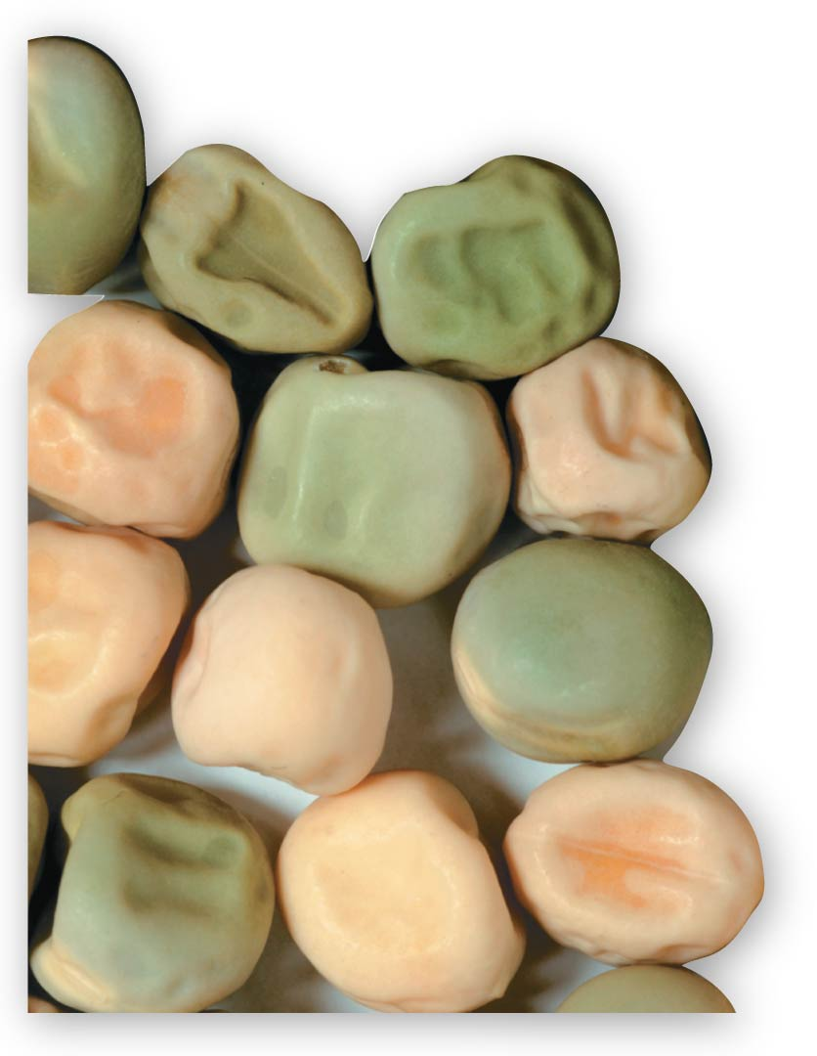
Notes:
Figure 9.8-4 Testing alternative hypotheses for gene assortment in a dihybrid cross (part 4: peas photo)

Slide 37
Mendel’s Law of Independent Assortment
Mendel’s dihybrid cross supported the hypothesis that each pair of alleles segregates independently of the other pairs during gamete formation.
Thus, the inheritance of one character has no effect on the inheritance of another.
This is called Mendel’s law of independent assortment（自由组合定律）.
Independent assortment is seen in the inheritance of two characters in Labrador retrievers（拉布拉多）.
Notes:
37

Slide 38
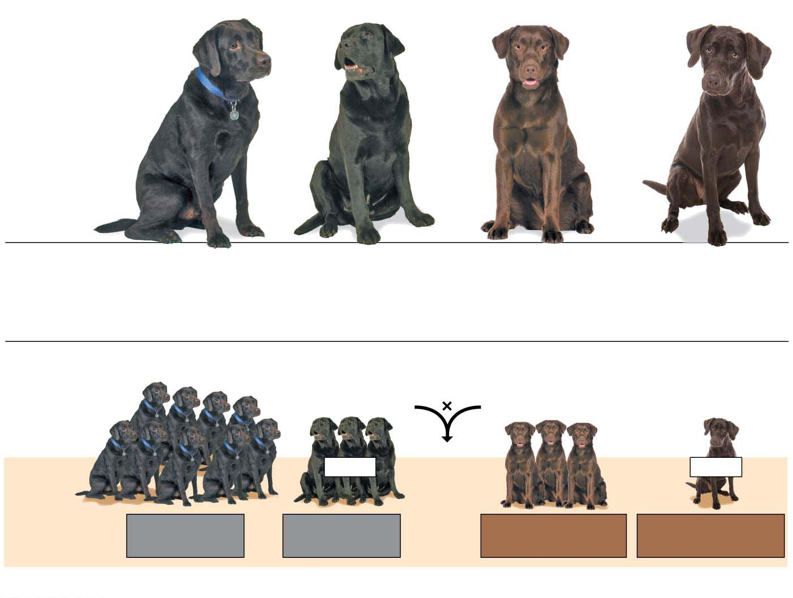
Blind dog
Blind dog
Phenotypes
Black coat,
normal vision
Black coat,
blind (PRA)
Chocolate coat,
normal vision
Chocolate coat,
blind (PRA)
Genotypes
B_N_
B_nn
bbN_
bbnn
(a) Possible phenotypes of Labrador retrievers
Mating of double heterozygotes（杂合子）
(black coat, normal vision)
BbNn
BbNn
Blind
Blind
Phenotypic
ratio of
offspring
9 black coat,
normal vision
3 black coat,
blind (PRA)
3 chocolate coat,
normal vision
1 chocolate coat,
blind (PRA)
(b) A Labrador dihybrid cross
Notes:
Figure 9.9 Independent assortment of genes in Labrador retrievers

Slide 39
Using a Testcross to Determine an Unknown Genotype
A testcross（测交） is a mating between an individual of dominant phenotype (but unknown genotype) and a homozygous recessive individual.
Next figure shows the offspring that could result from such a mating.
Notes:
39

Slide 40
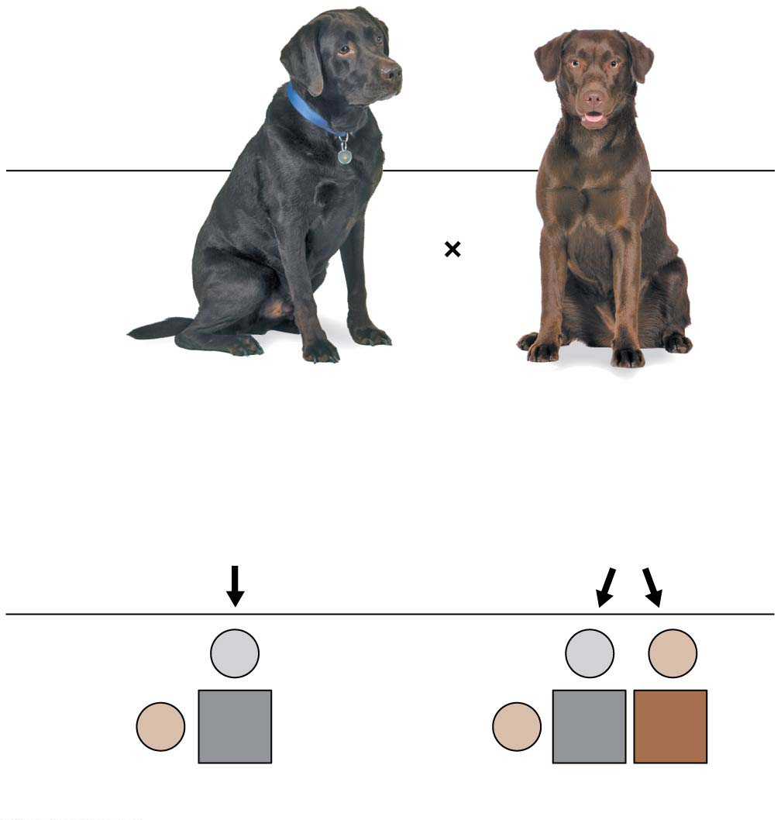
Figure 9.10
Testcross
Genotypes
B_
bb
Two possible genotypes for the black dog:
BB
or
Bb
Gametes
B
B
b
b
Bb
b
Bb
bb
Offspring
All black
1 black : 1 chocolate
Notes:
Figure 9.10 A Labrador retriever testcross

Slide 41
The Rules of Probability
Mendel’s strong background in mathematics helped him understand patterns of inheritance.
For instance, he understood that genetic crosses obey the rules of probability—the same rules that apply when tossing coins, rolling dice, or drawing cards.
The rule of multiplication states that the probability of a compound event is the product of the separate probabilities of the independent events.
Notes:
41

Slide 42
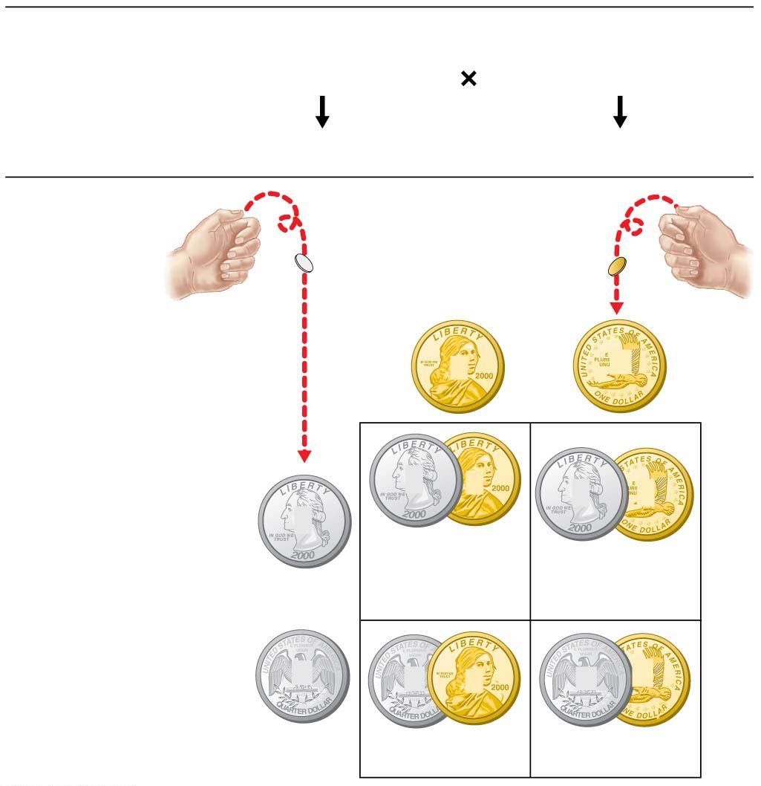
F₁ Genotypes
Bb female
⋅
Bb male
Formation of eggs
Formation of sperm
F₂ Genotypes
Male
gametes
1
2
B
1
2
b
B
B
B
b
1
2
B
1
4
1
4
Female gametes
(
1
2
⋅
1
2
)
1
2
b
b
B
b
b
1
4
1
4
Notes:
Figure 9.11 Segregation of alleles and fertilization as chance events

Slide 43
Family Pedigrees（家谱）
Mendel’s principles apply to the inheritance of many human traits.
Next figure illustrates alternative forms of three human characters that are each thought to be determined by simple dominant-recessive inheritance of one gene.
Notes:
43

Slide 44
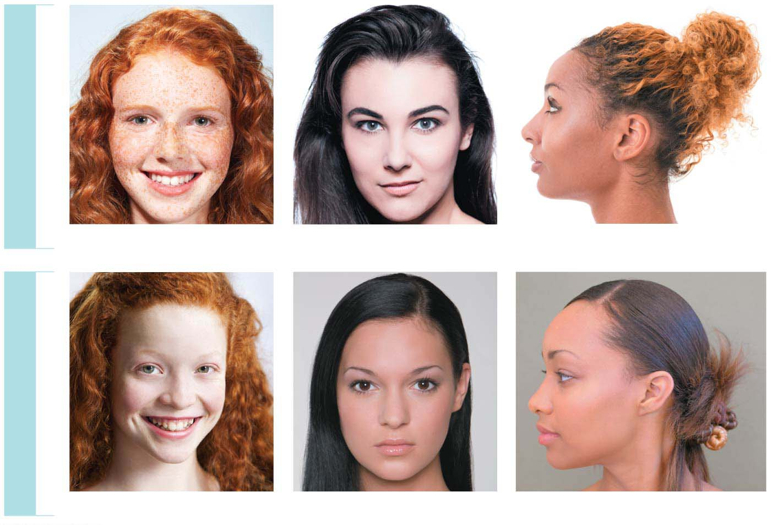
DOMINANT TRAITS
Freckles
Widow’s peak
Free earlobe
RECESSIVE TRAITS
No freckles
Straight hairline
Attached earlobe
Notes:
Figure 9.12 Examples of inherited human traits thought to be controlled by a single gene

Slide 45
Family Pedigrees
A trait that is dominant does not imply that it is either normal or more common than a recessive phenotype.
Wild-type traits (those seen most often in nature) are not necessarily specified by dominant alleles.
Notes:
45

Slide 46
Family Pedigrees
How can human genetics be studied?
Geneticists
analyze the results of matings that have already occurred and
assemble this information into a family tree, called a pedigree.
Next figure shows a pedigree tracing the incidence of free versus attached earlobes.
Mendel’s laws enable us to deduce the genotypes for most of the people in the pedigree.
Notes:
46

Slide 47
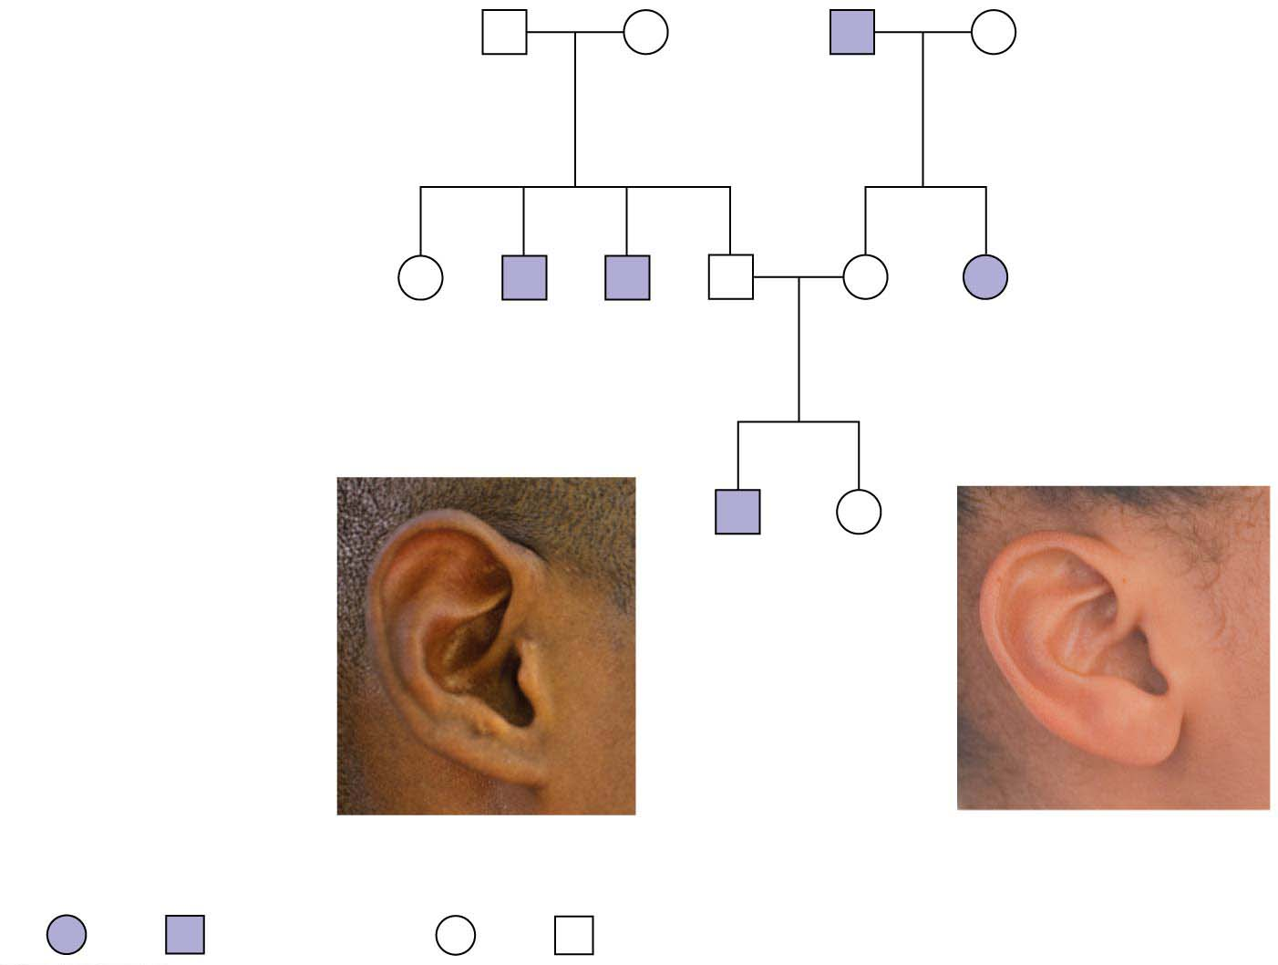
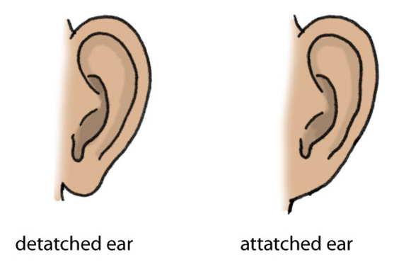
First generation
(grandparents)
Aaron
Ff
Betty
Ff
Cletus
ff
Debbie
Ff
Second generation
(parents, aunts, and
uncles)
Evelyn
FF
or
Ff
Fred
ff
Gabe
ff
Hal
Ff
Ina
Ff
Julia
ff
Third generation
(brother and
sister)
Kevin
ff
Lisa
FF
or
Ff
Female
Male
Female
Male
Attached
Free
Notes:
Figure 9.13-1 A family pedigree showing inheritance of free versus attached earlobes (part 1: pedigree)

Slide 48
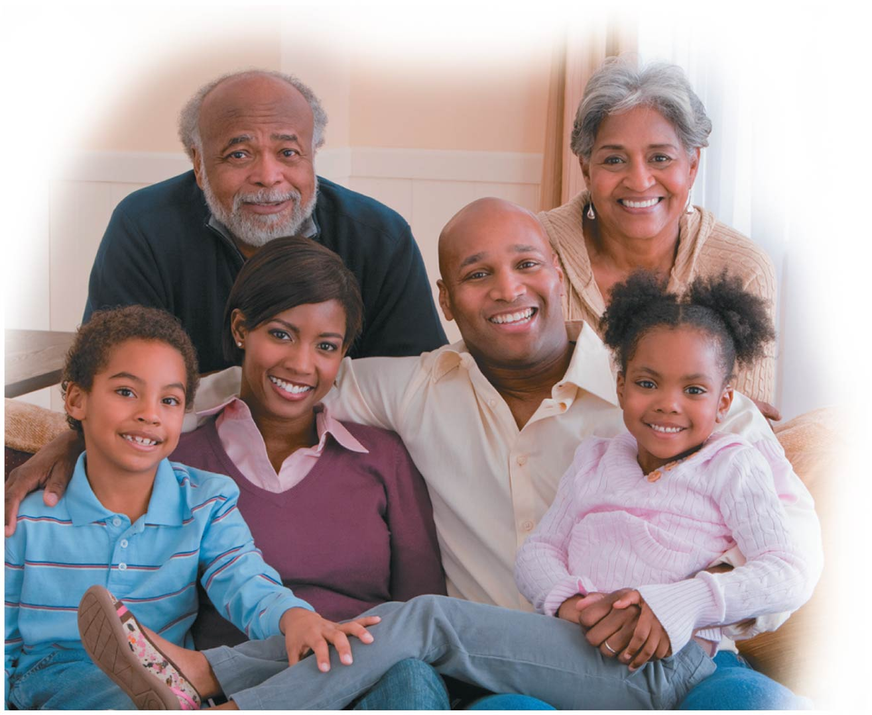
Notes:
Figure 9.13-2 A family pedigree showing inheritance of free versus attached earlobes (part 2: family)

Slide 49
Human Disorders Controlled by a Single Gene
Some human genetic disorders are known to be inherited as dominant or recessive traits controlled by a single gene, all located on autosomes（常染色体）, chromosomes other than the sex chromosomes X and Y.
These disorders are listed in next Table.
Notes:
49

Slide 50
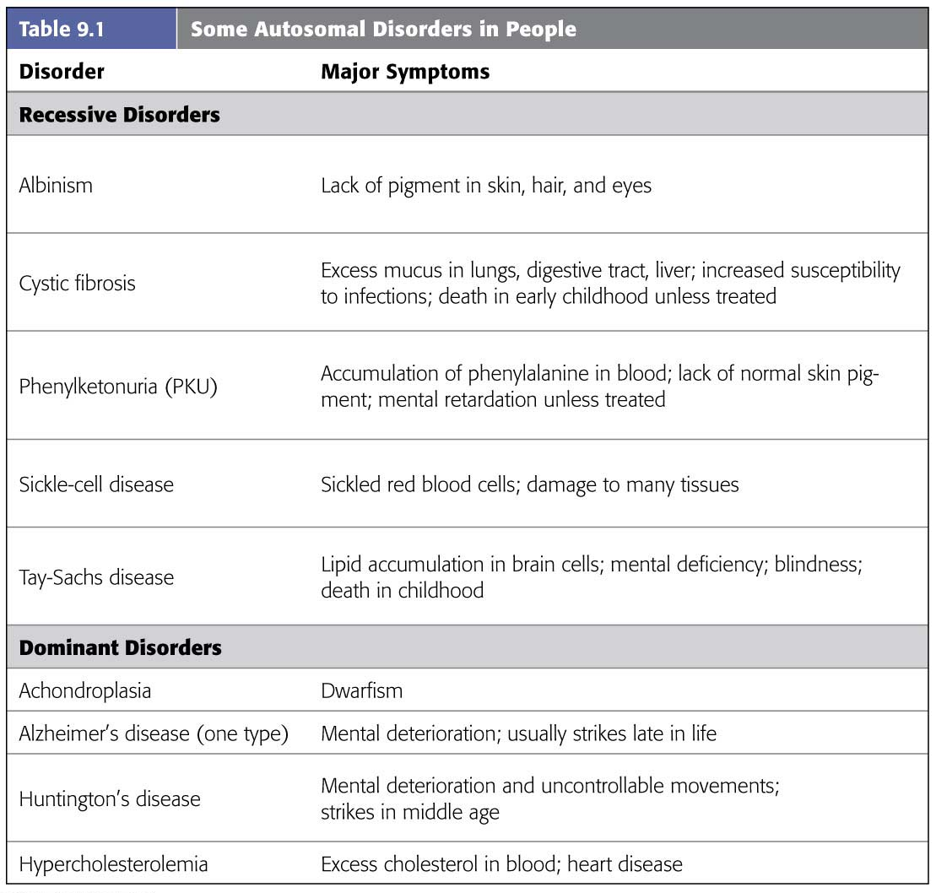
白化病
囊胞性纤维症
苯酮尿症
镰刀形细胞贫血症
软骨发育不全
老年痴呆
高胆固醇血症
Notes:
Table 9.1 Some autosomal disorders in people

Slide 51
Recessive Disorders
Most human genetic disorders are recessive.
Individuals who have the recessive allele but appear normal are carriers of the disorder.
Using Mendel’s laws, we can predict the fraction of affected offspring that is likely to result from a marriage between two carriers.
Notes:
51

Slide 52
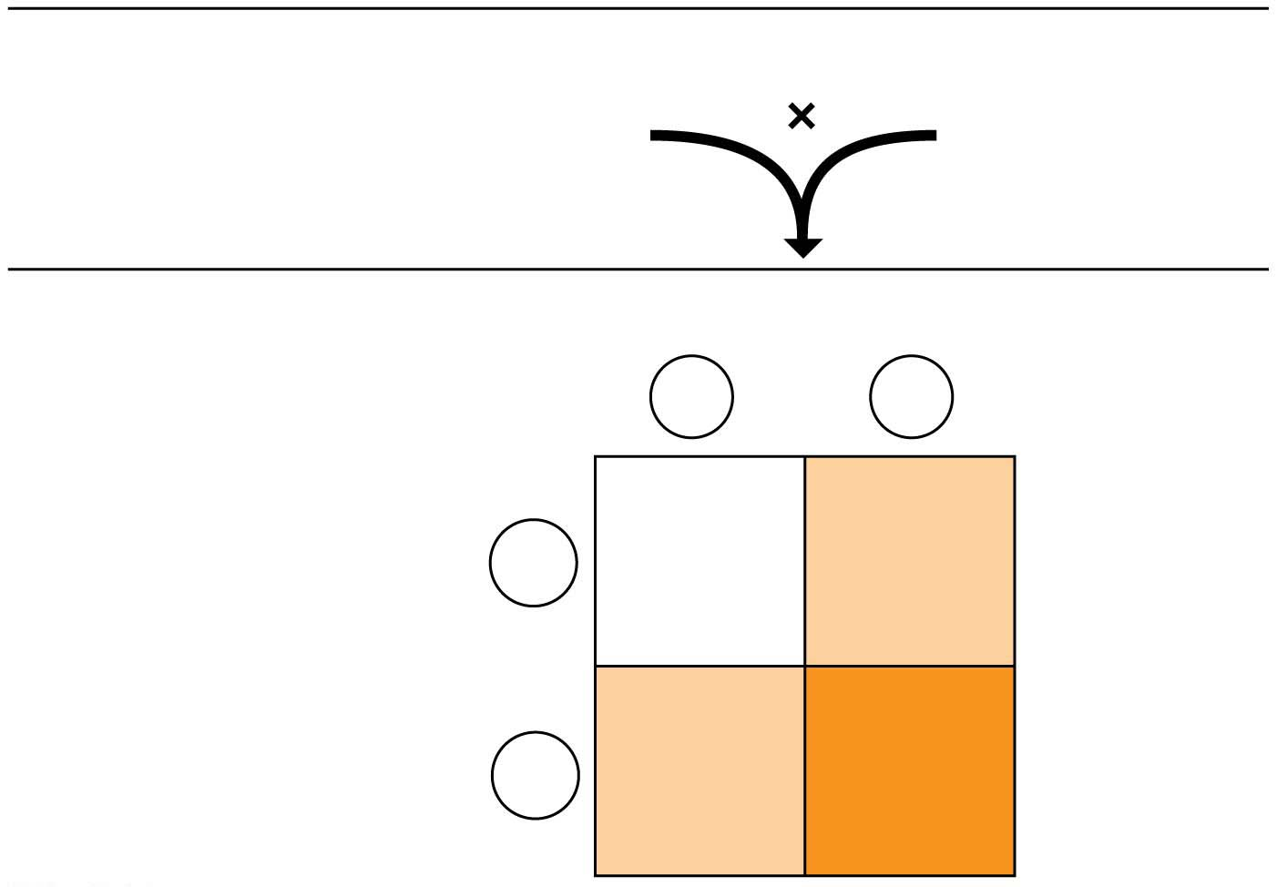
Parents
Hearing
Dd
Hearing
Dd
Offspring
D
Sperm
d
Dd
Hearing
(carrier)
DD
Hearing
D
Eggs
Dd
Hearing
(carrier)
dd
Deaf
d
Notes:
Figure 9.14 Predicted offspring when both parents are carriers for a recessive disorder

Slide 53
Recessive Disorders
Cystic fibrosis is
the most common lethal genetic disease in the United States and
caused by a recessive allele carried by about 1 in 31 Americans.
CF is caused by a mutation in the gene cystic fibrosis transmembrane conductance regulator (CFTR) found in chromosome 7.
Notes:
53

Slide 54
Dominant Disorders
A number of human disorders are caused by dominant alleles.
Achondroplasia is a form of dwarfism.
The homozygous dominant genotype (AA) causes death of the embryo.
Therefore, only heterozygotes (Aa), individuals with a single copy of the defective allele, have this disorder.
This also means that a person with achondroplasia has a 50% chance of passing the condition on to any children.
Notes:
54

Slide 55
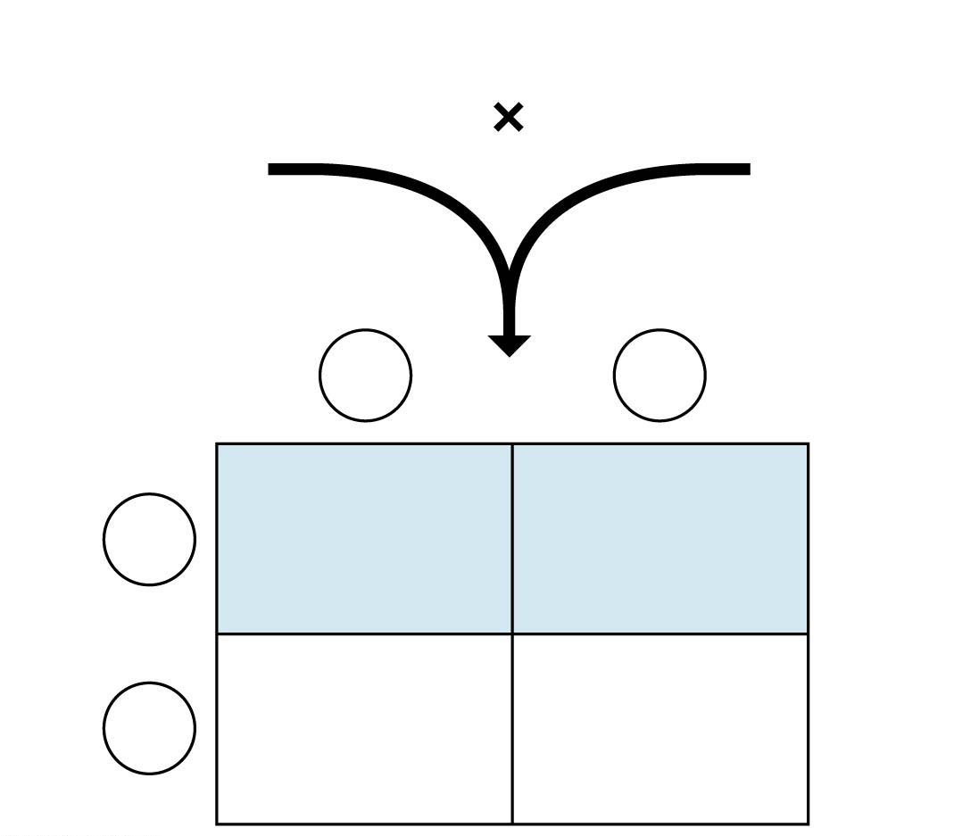
Parents
Normal
(no achondroplasia)
dd
Dwarf
(achondroplasia)
Dd
d
Sperm
d
Dd
Dwarf
Dd
Dwarf
D
Eggs
dd
Normal
dd
Normal
d
Notes:
Figure 9.15 A Punnett square illustrating a family with and without achondroplasia

Slide 56
Dominant Disorders
Dominant alleles that cause lethal disorders are much less common than lethal recessive alleles.
One example is the allele that causes Huntington’s disease, a degeneration of the nervous system that usually does not begin until middle age.
Once the deterioration of the nervous system begins, it is irreversible and inevitably fatal（致命的）.
Because the allele for Huntington’s disease is dominant, any child born to a parent with the allele has a 50% chance of inheriting the allele and the disorder.
Notes:
56

Slide 57
The Process of Science: What Is the Genetic Basis of Coat Variation in Dogs?
Observation: Dogs come in a wide variety of physical types.
Question: What is the genetic basis for canine coats?
Hypothesis: A comparison of genes of a wide variety of dogs with different coats would identify the genes responsible.
Notes:
57

Slide 58
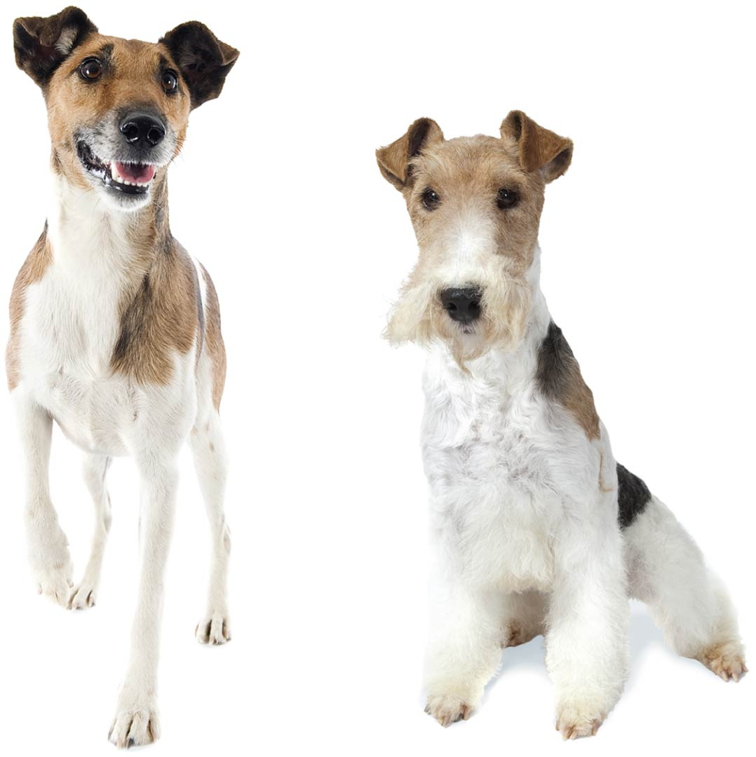
Notes:
Figure 9.16 Smooth versus wired fox terrier

Slide 59
The Process of Science: What Is the Genetic Basis of Coat Variation in Dogs?
Prediction: Mutations in just a few genes account for the coat appearance.
Experiment: Researchers compared DNA sequences of 622 dogs from dozens of breeds.
Results: Three genes in different combinations produced seven different coat appearances, from very short hair to full, thick, wired hair.
Notes:
59

Slide 60
Genetic Testing
Today many tests can detect the presence of disease-causing alleles.
Most genetic tests are performed during pregnancy if the prospective parents are aware that they have an increased risk of having a baby with a genetic disease.
In amniocentesis（羊膜穿刺术）, a physician uses a needle to extract about 2 teaspoons of the fluid that bathes the developing fetus（胎儿）.
Notes:
60

Slide 61
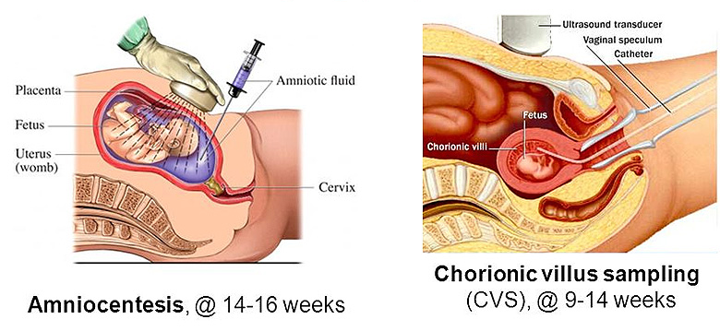
Genetic Testing
In chorionic villus（绒毛） sampling, a physician inserts a narrow, flexible tube through the mother’s vagina and into her uterus（子宫）, removing some placental tissue（胎盘组织）.
Newer genetic screening procedures involve isolating tiny amounts of fetal cells or DNA released into the mother’s bloodstream. These newer technologies are gradually replacing more invasive screening methods because they
are more accurate and
can be performed earlier than other tests.
Notes:
61

Slide 62
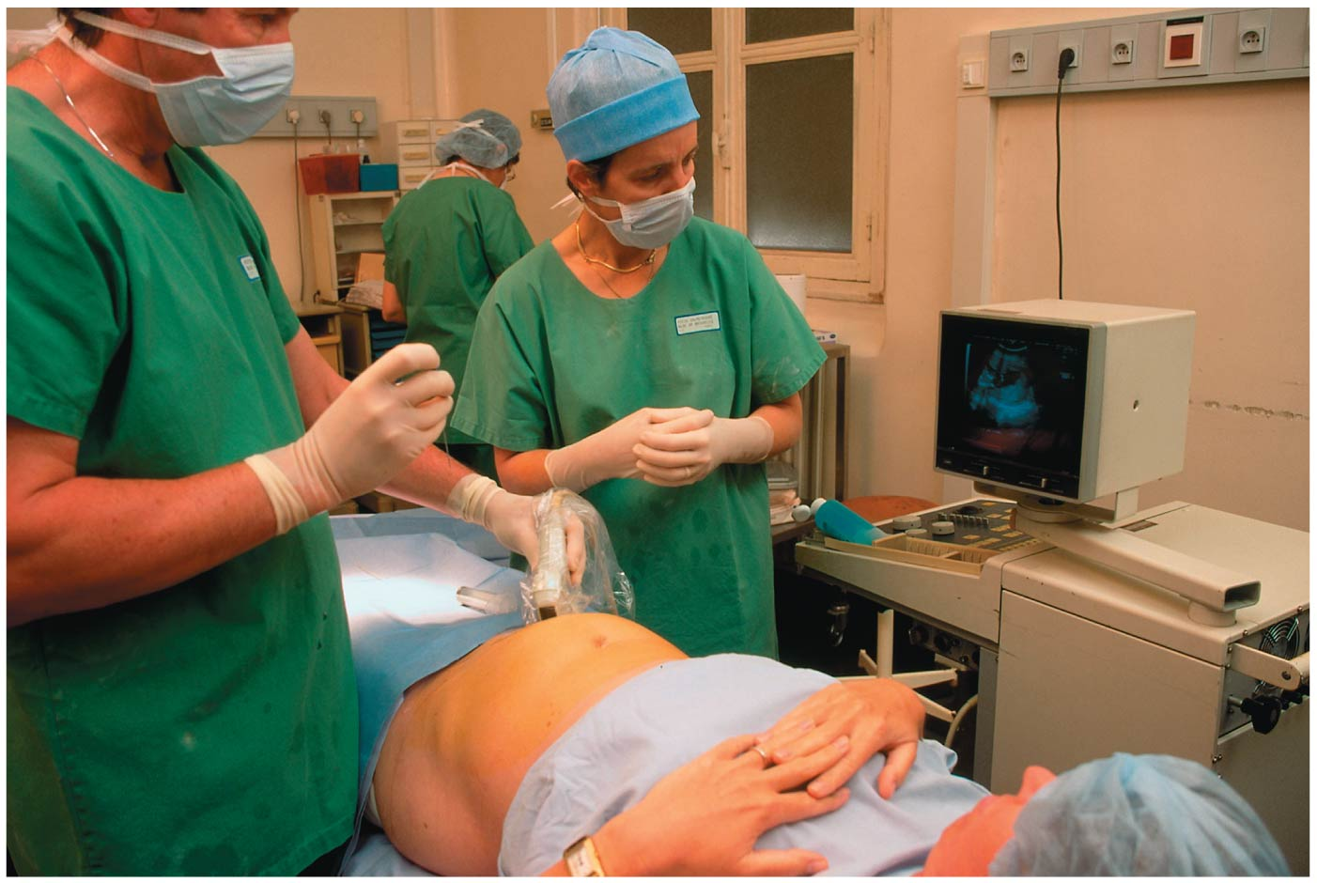
Notes:
Figure 9.17 Amniocentesis

Slide 63
Genetic Testing
Once cells are obtained, they can be screened for genetic diseases.
Patients seeking genetic testing should receive counseling both before and after to explain the test and to help them cope with the results.
Notes:
63

Slide 64
Variations on Mendel’s Laws
Mendel’s two laws explain inheritance in terms of genes that are passed along from generation to generation according to simple rules of probability.
These laws are valid for all sexually reproducing organisms.
But Mendel’s laws stop short of explaining some patterns of genetic inheritance.
In fact, for most sexually reproducing organisms, cases in which Mendel’s rules can strictly account for the patterns of inheritance are relatively rare.
More often, the observed inheritance patterns are more complex.
Notes:
64

Slide 65
Incomplete Dominance in Plants and People
In incomplete dominance（半显性）, F₁ hybrids have an appearance between the phenotypes of the two parents.
Notes:
65

Slide 66
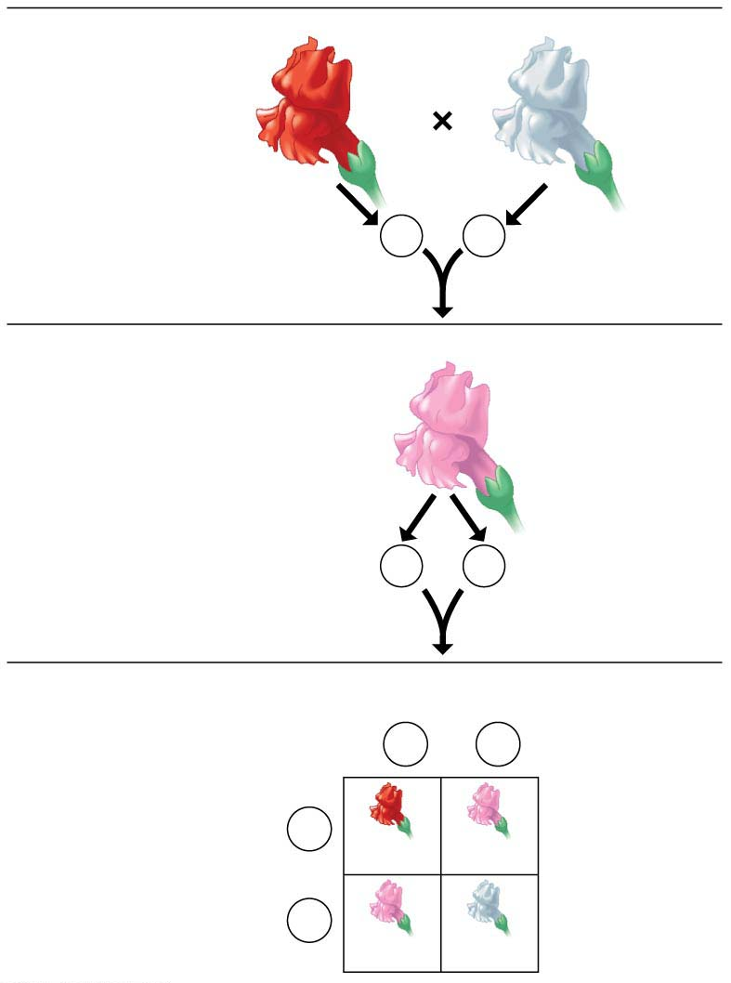
P Generation
Red
RR
White
rr
Gametes
R
r
F₁ Generation
Pink
Rr
Gametes
1
2
R
1
2
r
F₂ Generation
Sperm
1
2
R
1
2
r
1
2
R
Eggs
RR
Rr
1
2
r
Rr
rr
Notes:
Figure 9.18-s3 Incomplete dominance in snapdragons (step 3)

Slide 67
Incomplete Dominance in Plants and People
Hypercholesterolemia（高胆固醇血症）
is a human trait that is an example of incomplete dominance and
is characterized by dangerously high levels of cholesterol in the blood.
Notes:
67

Slide 68
Incomplete Dominance in Plants and People
In hypercholesterolemia,
Heterozygotes（杂合子） have blood cholesterol levels about twice normal, while
Homozygotes（纯合子） have about five times the normal amount of blood cholesterol and may have heart attacks as early as age 2.
Notes:
68

Slide 69
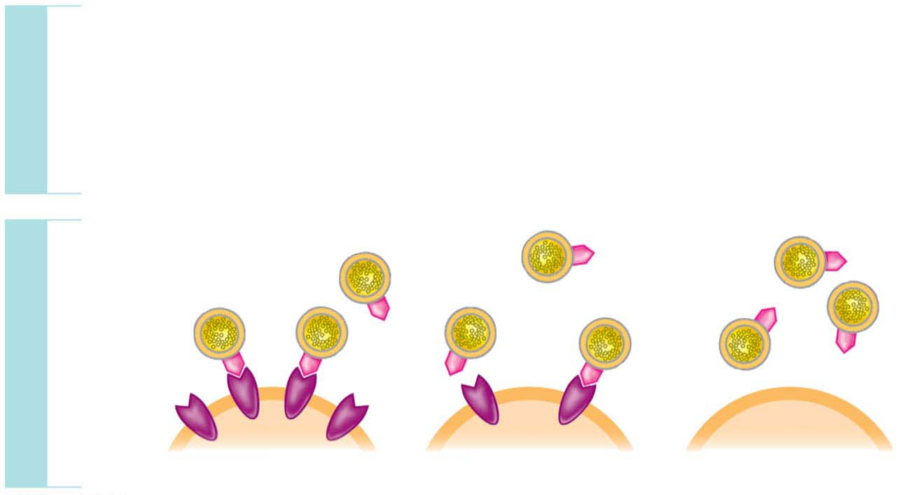
Incomplete dominance in human hypercholesterolemia
HH
Homozygous
for ability to make
LDL receptors
Hh
Heterozygous
hh
Homozygous
for inability to make
LDL receptors
GENOTYPE
LDL
LDL
receptor
PHENOTYPE
Cell
Normal
Mild disease
Severe disease
Notes:
Figure 9.19 Incomplete dominance in human hypercholesterolemia

Slide 70
ABO Blood Groups: An Example of Multiple Alleles and Codominance
The ABO blood groups（ABO血型系统） in humans involve three alleles of a single gene.
Various combinations of these three alleles produce four phenotypes: A person’s blood type may be A, B, AB, or O.
These letters refer to two carbohydrates, designated A and B, that may be found on the surface of red blood cells.
Notes:
70

Slide 71
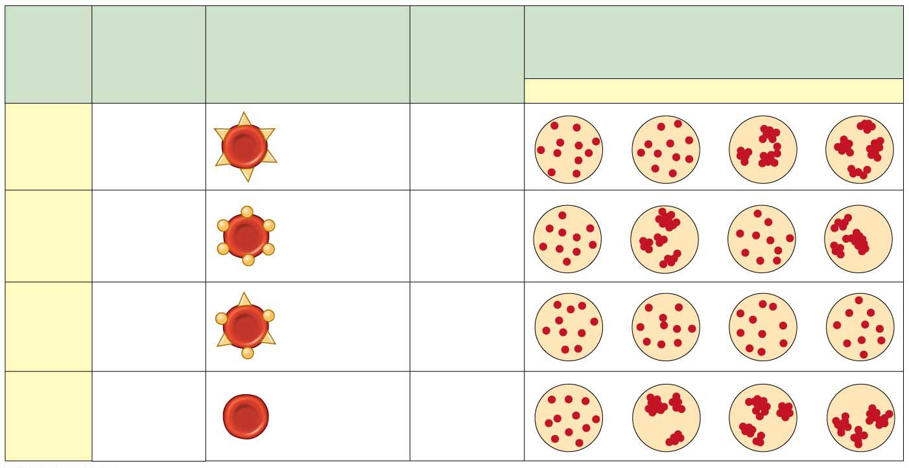
Multiple alleles for the ABO blood groups
Blood
Group
(Pheno-
type)
Antibodies（抗体）
Present in
Blood
Reactions When Blood from Groups
Below Is Mixed with Antibodies from
Groups at Left
Genotypes
Red Blood Cells
O
A
B
AB
I^{A} I^{A}
Carbohydrate
A
A
or
Anti-B
I^{A}i
I^{B} I^{B}
Carbohydrate
B
B
or
Anti-A
I^{B} i
AB
I^{A} I^{B}
O
Anti-A
Anti-B
^{ii}
Notes:
Figure 9.20 Multiple alleles for the ABO blood groups

Slide 72
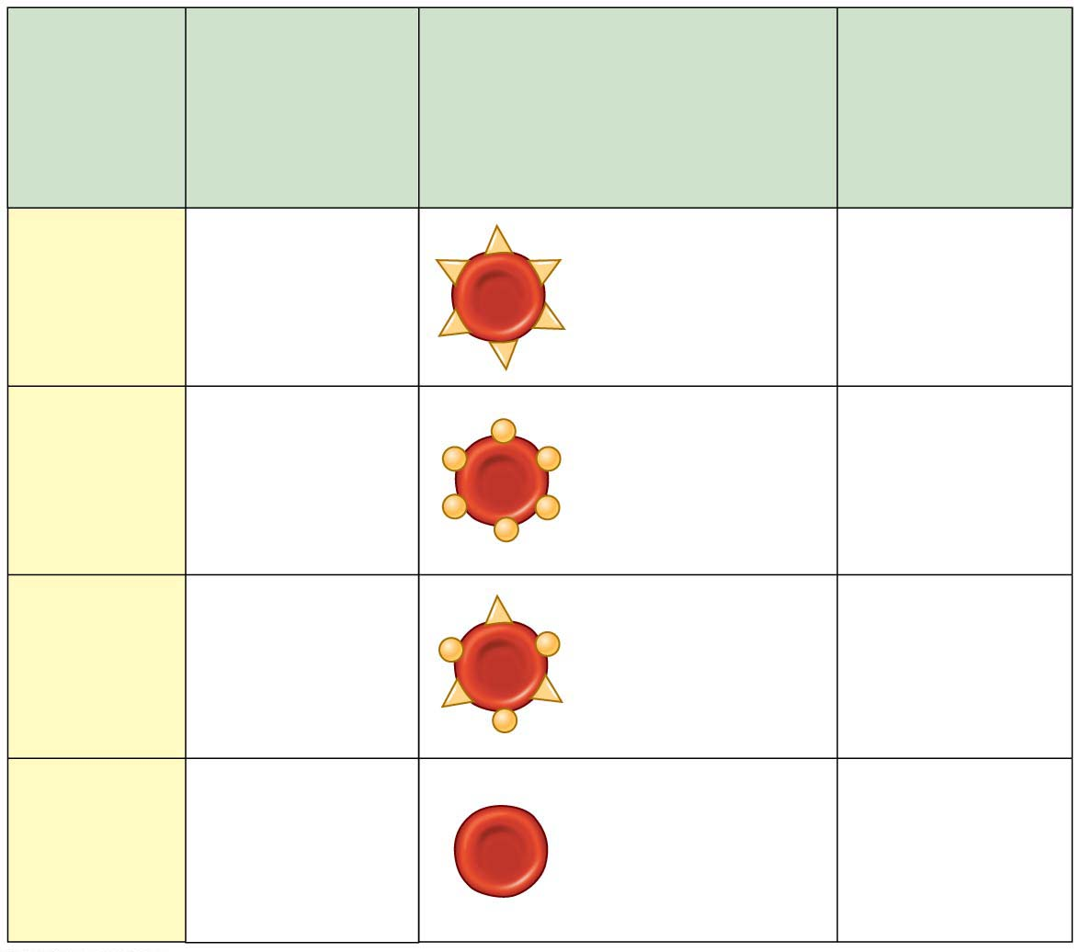
Blood
Group
(Pheno-
type)
Antibodies
Present in
Blood
Genotypes
Red Blood Cells
I
A
I
A
Carbohydrate
A
A
or
Anti-B
I
A
i
B
B
Carbohydrate
B
I
I
B
or
Anti-A
I
B
i
AB
I
A
I
B
Anti-A
Anti-B
O
ii
Notes:
Figure 9.20-1 Multiple alleles for the ABO blood groups (part 1: genotypes and antibodies)

Slide 73
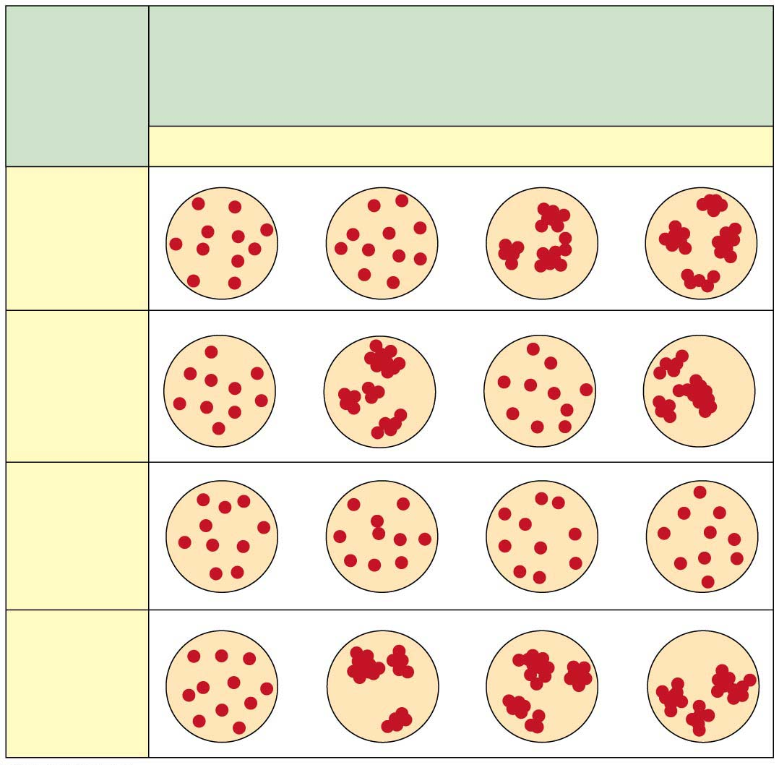
Blood
Group
(Pheno-
type)
Reactions When Blood from Groups
Below Is Mixed with Antibodies from
Groups at Left
O
A
B
AB
A
B
AB
O
Notes:
Figure 9.20-2 Multiple alleles for the ABO blood groups (part 2: reactions)

Slide 74
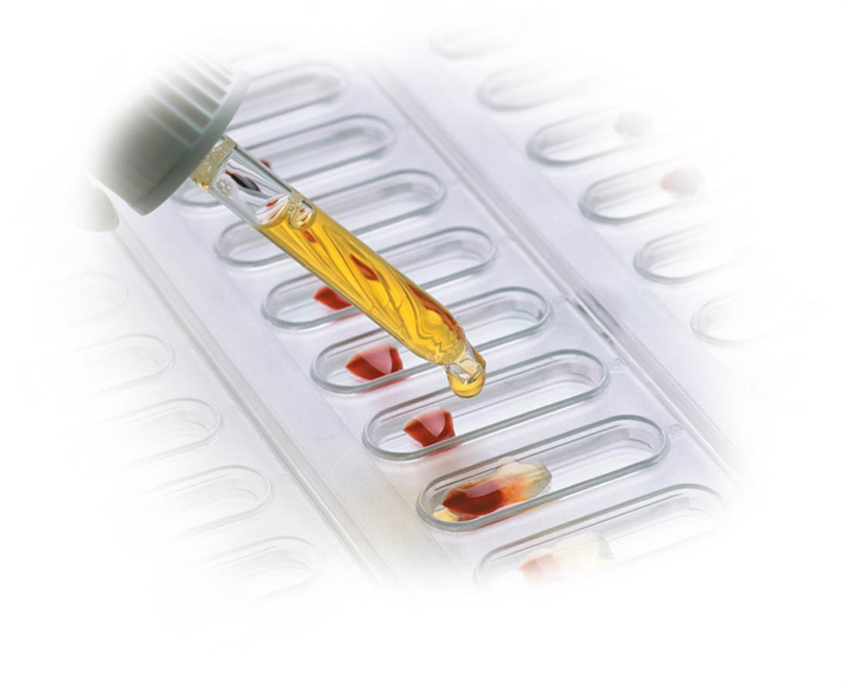
Notes:
Figure 9.20-3 Multiple alleles for the ABO blood groups (part 3: blood-typing photo)

Slide 75
ABO Blood Groups: An Example of Multiple Alleles and Codominance
Matching compatible blood groups is critical for safe blood transfusions. If a donor’s blood cells have a carbohydrate (A or B) that is foreign to the recipient, then the recipient’s immune system produces blood proteins called antibodies that bind to the foreign carbohydrates and cause the donor blood cells to clump together, potentially killing the recipient.

Slide 76
ABO Blood Groups: An Example of Multiple Alleles and Codominance
The four blood groups result from various combinations of the three different alleles:
I^{A} (for the ability to make substance A),
I^{B} (for B), and
i (for neither A nor B).
Each person inherits one of these alleles from each parent.

Slide 77
ABO Blood Groups: An Example of Multiple Alleles and Codominance
Because there are three alleles, there are six possible genotypes, as listed in Figure 9.20.
Both the I^{A} and I^{B} alleles are dominant to the i allele.
People of genotype I^{A}I^{B} make both carbohydrates. In other words, the I^{A} and I^{B} alleles are codominant, meaning that both alleles are expressed in heterozygous individuals (I^{A}I^{B}) who have type AB blood.

Slide 78
Structure/Function: Pleiotropy（基因多效性） and Sickle-Cell Disease
Pleiotropy is when one gene influences several characters.
Sickle-cell disease
exhibits pleiotropy,
results in abnormal hemoglobin proteins, and
causes disk-shaped red blood cells to deform into a sickle shape with jagged edges（锯齿边缘）.
In most cases, only people who are homozygous for the sickle-cell allele have sickle-cell disease.
Notes:
78

Slide 79
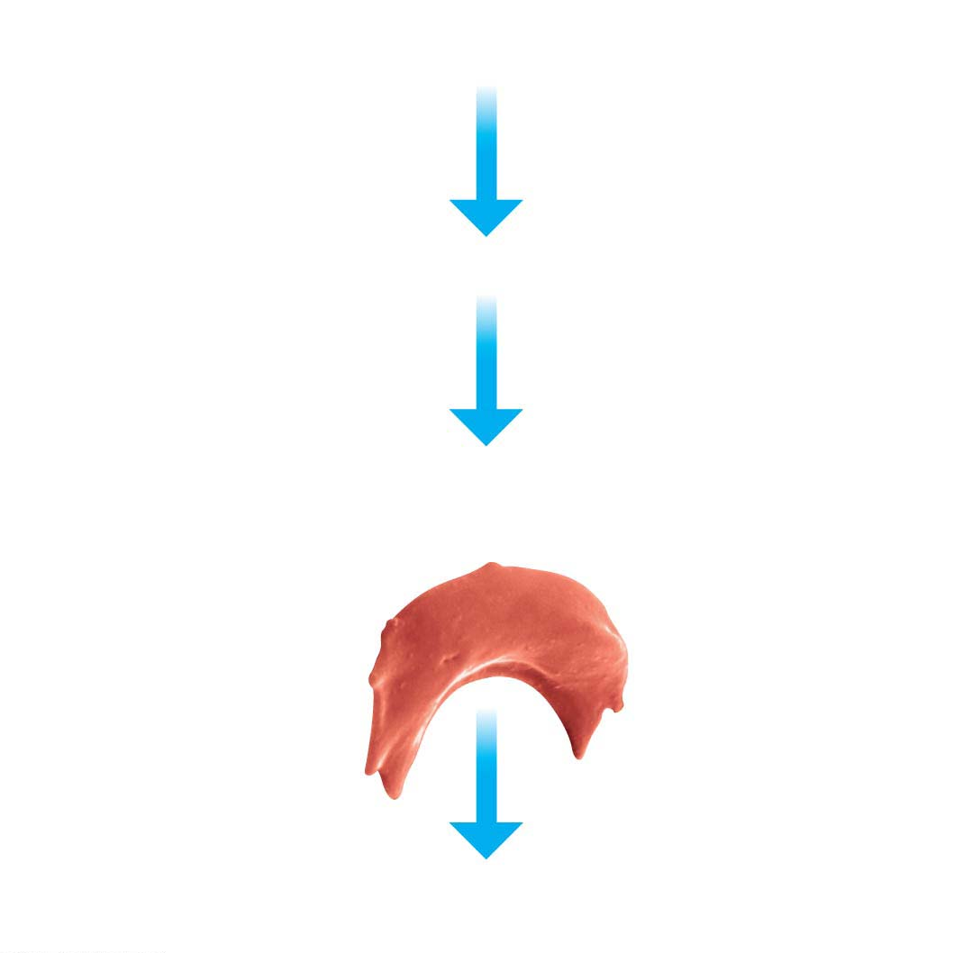
Individual homozygous
for sickle-cell allele
Sickle-cell (abnormal) hemoglobin
Abnormal hemoglobin crystallizes into long, flexible chains,
causing red blood cells to become sickle-shaped.
Colorized SEM
Sickled cells can lead to a cascade of symptoms, such as
weakness, pain, organ damage, and paralysis（麻痹）.
Notes:
Figure 9.21 Sickle-cell disease: multiple effects of a single human gene

Slide 80
Polygenic Inheritance
Polygenic inheritance is
the additive effects of two or more genes on a single phenotypic character and
the logical opposite of pleiotropy（基因多效性）, in which one gene affects several characters.
There is evidence that height in people is controlled by several genes that are inherited separately. (Actually, human height is probably affected by a great number of genes, but we’ll simplify here.)
Notes:
80

Slide 81
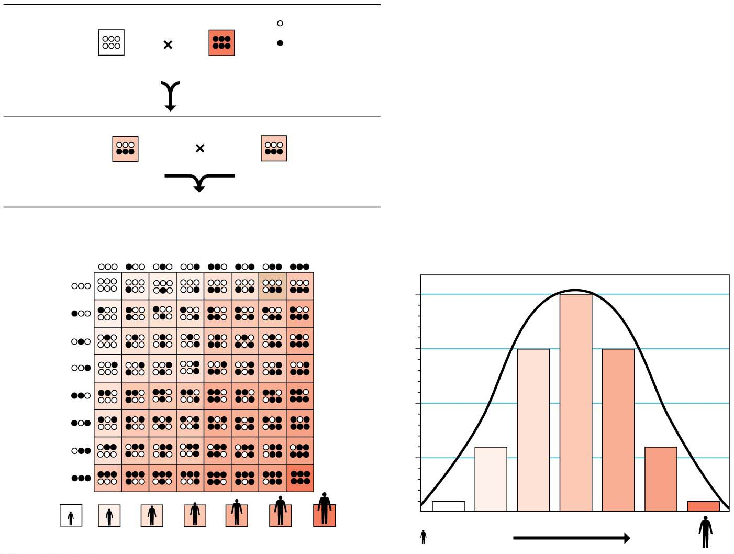
P Generation
= short allele
= tall allele
aabbcc
(very short)
AABBCC
(very tall)
F₁ Generation
AaBbCc
(medium height)
AaBbCc
(medium height)
F₂ Generation
Sperm
1
8
1
8
1
8
1
8
1
8
1
8
1
8
1
8
1
8
20
64
1
8
1
8
15
64
1
8
Eggs
1
8
Fraction of population
1
8
1
8
6
64
1
8
1
64
1
64
6
64
15
64
20
64
15
64
6
64
1
64
Very short
Adult height
Very tall
Notes:
Figure 9.22 A model for polygenic inheritance of height

Slide 82
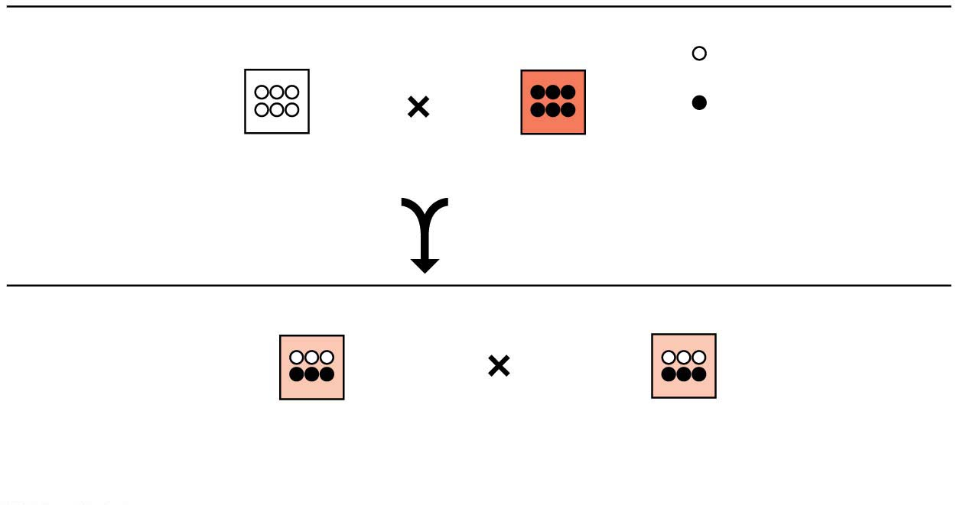
P Generation
= short allele
= tall allele
aabbcc
(very short)
AABBCC
(very tall)
F₁ Generation
AaBbCc
(medium height)
AaBbCc
(medium height)
Notes:
Figure 9.22-1 A model for polygenic inheritance of height (part 1: P and F₁ generations)

Slide 83
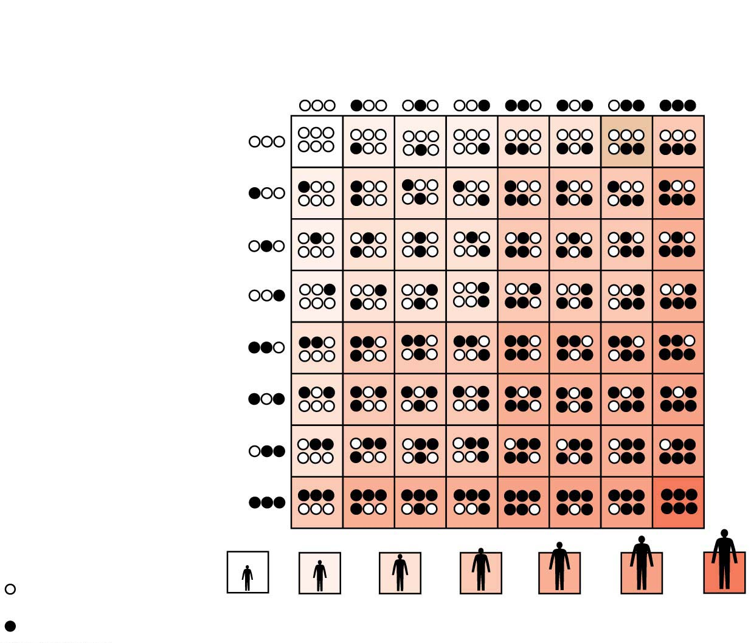
Figure 9.22-2
F₂ Generation
Sperm
1
8
1
8
1
8
1
8
1
8
1
8
1
8
1
8
1
8
1
8
1
8
1
8
Eggs
1
8
1
8
1
8
1
8
= short allele
1
64
6
64
15
64
20
64
15
64
6
64
1
64
= tall allele
Notes:
Figure 9.22-2 A model for polygenic inheritance of height (part 2: F₂ generation)

Slide 84
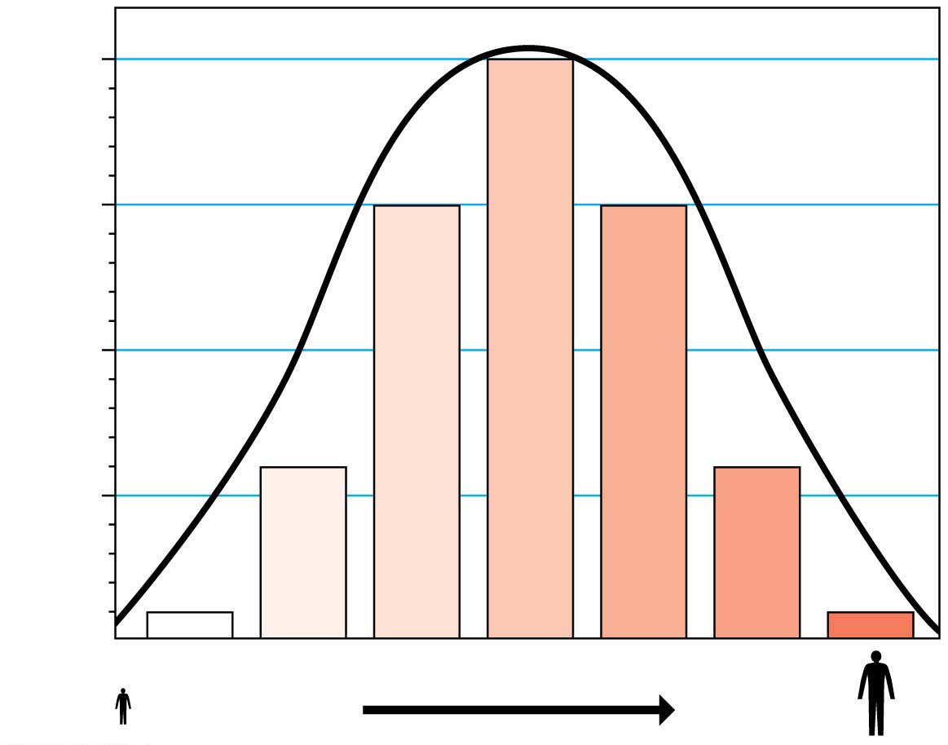
Figure 9.22-3
20
64
15
64
Fraction of population
6
64
1
64
Adult height
Very short
Very tall
Notes:
Figure 9.22-3 A model for polygenic inheritance of height (part 3: bell curve)

Slide 85
Epigenetics and the Role of Environment
Many phenotypic characters result from a combination of heredity and environment.
Whether human characters are more influenced by genes or by the environment—nature or nurture—is a very old and hotly contested issue.
Spending time with identical twins will convince anyone that environment, and not just genes, affects a person’s traits.
Notes:
85

Slide 86
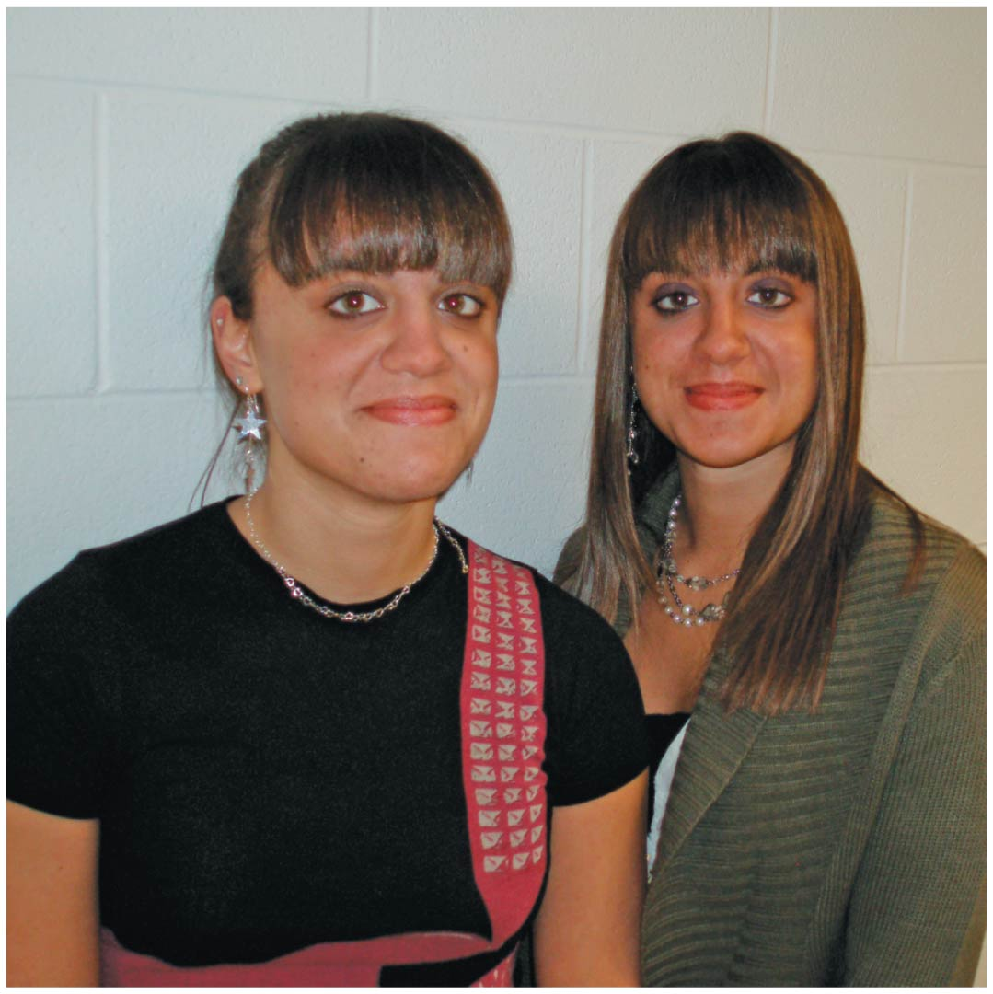
As a result of environmental influences, even identical twins can look different
Notes:
Figure 9.23-1 As a result of environmental influences, even identical twins can look different (part 1: identical twins)

Slide 87
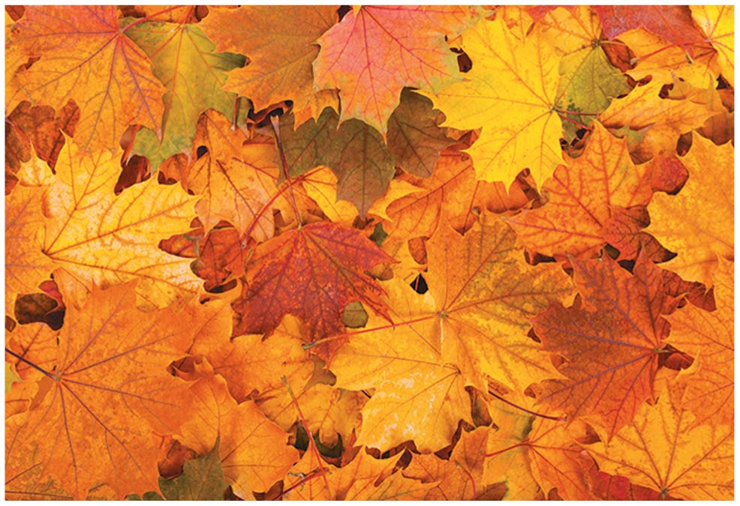
Notes:
Figure 9.23-2 As a result of environmental influences, even identical twins can look different (part 2: genetically identical leaves)

Slide 88
Epigenetics and the Role of Environment
In general, only genetic influences are inherited and effects of the environment are not passed to the next generation.
In recent years, however, biologists have begun to recognize the importance of epigenetic inheritance（基因调控的遗传）, the transmission of traits by mechanisms not directly involving DNA sequence.
Notes:
88

Slide 89
Epigenetics and the Role of Environment
For example, components of chromosomes can be chemically modified by adding or removing chemical groups on the DNA and/or protein components of chromosomes.
Over a lifetime, the environment plays a role in these changes, which may explain how one identical twin can suffer from a genetically based disease whereas the other twin does not, despite their identical genomes.
Notes:
89

Slide 90
Epigenetics and the Role of Environment
Epigenetic modifications—and the changes in gene activity that result—may even be carried on to the next generation.
Unlike alterations to the DNA sequence, chemical changes to the chromosomes can be reversed.
Notes:
90

Slide 91
The Chromosomal Basis of Inheritance
The chromosome theory of inheritance states that
genes are located at specific positions (loci) on chromosomes and
the behavior of chromosomes during meiosis（减数分裂） and fertilization accounts for inheritance patterns.
Notes:
91

Slide 92
The Chromosomal Basis of Inheritance
It is chromosomes that
undergo segregation and independent assortment during meiosis and
account for Mendel’s laws.
Notes:
92

Slide 93
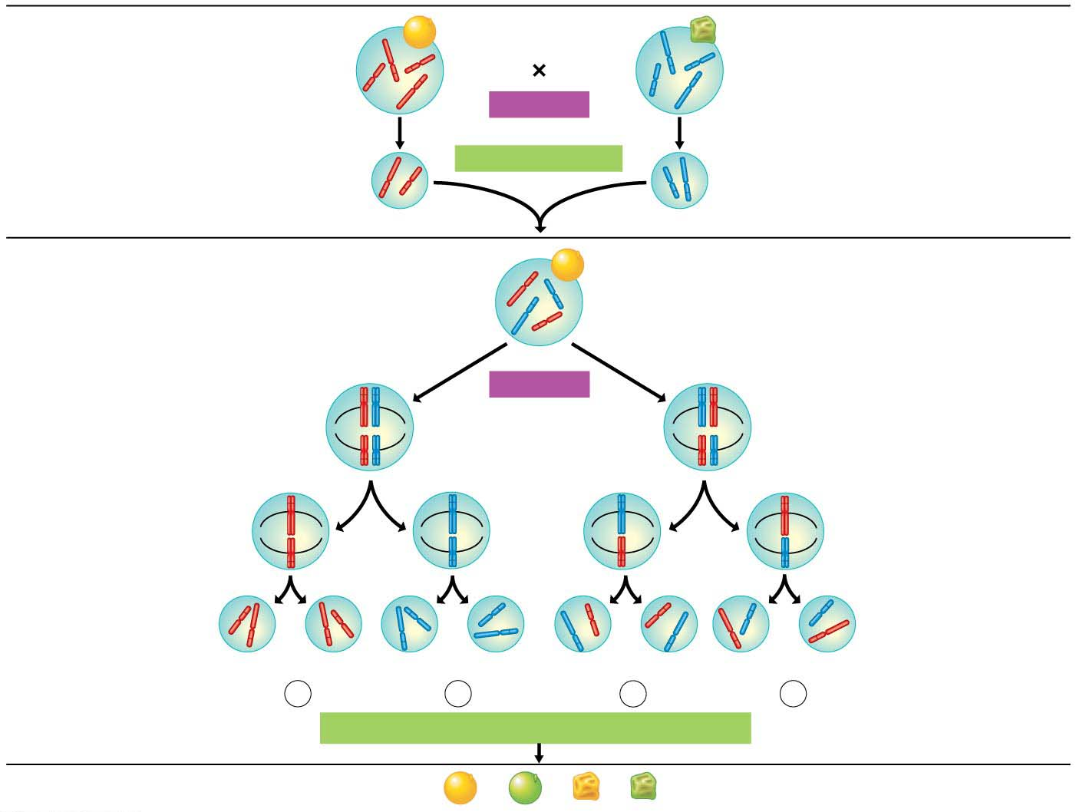
P Generation
Round-yellow
seeds
(RRYY)
Wrinkled-green
Seeds
(rryy)
Y
r
y
Y
R
R
y
r
MEIOSIS
FERTILIZATION
Gametes
y
r
R
Y
F₁ Generation
All round-yellow seeds
(RrYy)
R
y
Law of Segregation: Follow
the long chromosomes.
r
Law of Independent Assortment:
Follow both the long and the short
chromosomes.
Y
R
MEIOSIS
r
R
r
Metaphase I
(alternative
arrangements)
They are arranged in either
of two equally likely ways at
metaphase（细胞分裂中期） I.
The R and r alleles
segregate in anaphase（细胞分裂的后期） I.
Y
y
Y
y
R
r
Metaphase
II
r
R
Only one long
chromosome ends
up in each gamete.
They sort
independently, giving
four gamete types.
Y
y
Y
y
Y
Y
y
y
Y
Y
y
y
Gametes
R
R
r
r
r
r
R
R
1
4
RY
1
4
ry
1
4
rY
1
4
Ry
Fertilization results in the
9:3:3:1 phenotypic ratio
in the F₂ generation.
Fertilization recombines
the r and R alleles at random.
FERTILIZATION AMONG THE F₁ PLANTS
F₂ Generation
9
: 3
: 3
:1
Notes:
Figure 9.24 The chromosomal basis of Mendel’s laws

Slide 94
Linked Genes
Linked genes
are located near each other on the same chromosome and
tend to travel together during meiosis and fertilization.
Such genes are often inherited as a set and therefore often do not follow Mendel’s law of independent assortment.
Notes:
94

Slide 95
Sex Determination in Humans
Many animals, including all mammals, have a pair of sex chromosomes, designated X and Y, that determine an individual’s sex.
Individuals with one X chromosome and one Y chromosome are males.
XX individuals are females.
Human males and females both have 44 autosomes（常染色体） (chromosomes other than sex chromosomes).
Notes:
95

Slide 96
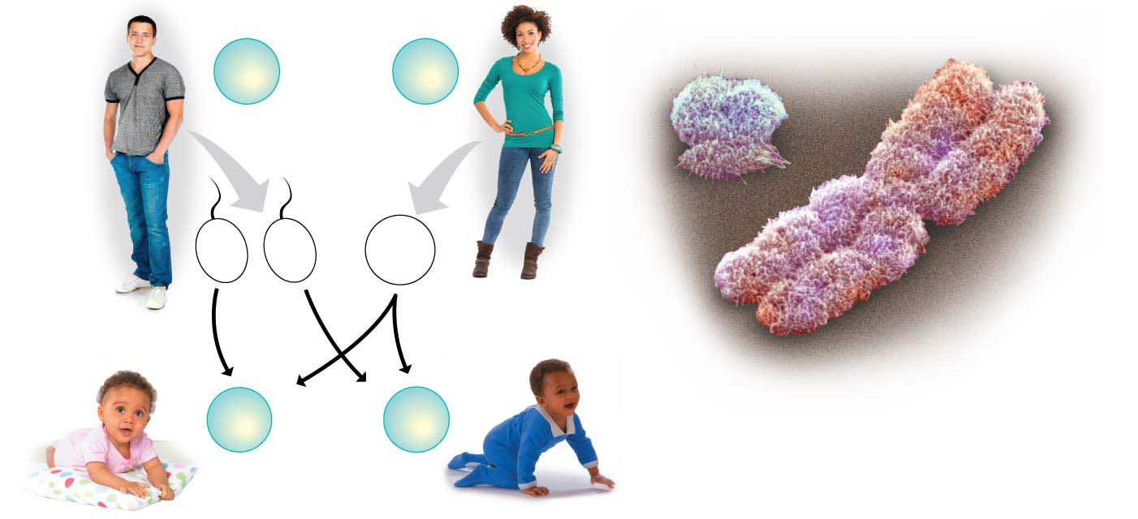
Male
Female
44
+
XY
Somatic
cells
44
+
XX
Y
X
Colorized SEM
22
+
X
22
+
Y
22
+
X
Sperm
Egg
44
+
XX
44
+
XY
Offspring
Female
Male
Notes:
Figure 9.25 The chromosomal basis of sex determination in humans

Slide 97
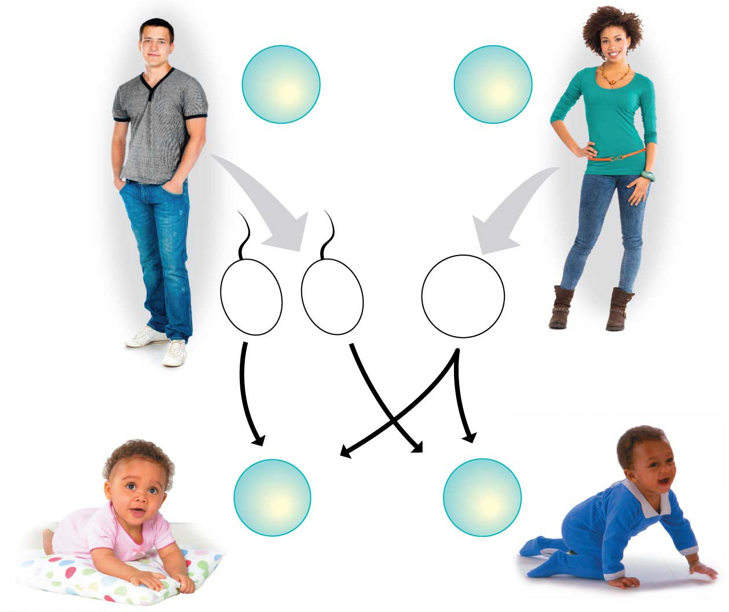
Male
Female
44
+
XY
Somatic
cells
44
+
XX
22
+
X
22
+
Y
22
+
X
Sperm
Egg
44
+
XX
44
+
XY
Offspring
Female
Male
Notes:
Figure 9.25-1 The chromosomal basis of sex determination in humans (part 1: diagram)

Slide 98
Sex-Linked Genes
A gene located on a sex chromosome is called a sex-linked gene.
Most sex-linked genes are found on the X chromosome.
Notes:
98

Slide 99
Sex-Linked Genes
A number of human conditions, including red-green colorblindness, hemophilia（血友病）, and a type of muscular dystrophy（肌肉萎缩症）, result from sex-linked recessive alleles.
Notes:
99

Slide 100
Sex-Linked Genes
Red-green colorblindness is a common sex-linked disorder caused by a malfunction of light-sensitive cells in the eyes.
Mostly males are affected, but heterozygous females have some defects, too.
Next figure shows a simple test for red-green colorblindness.
Notes:
100

Slide 101
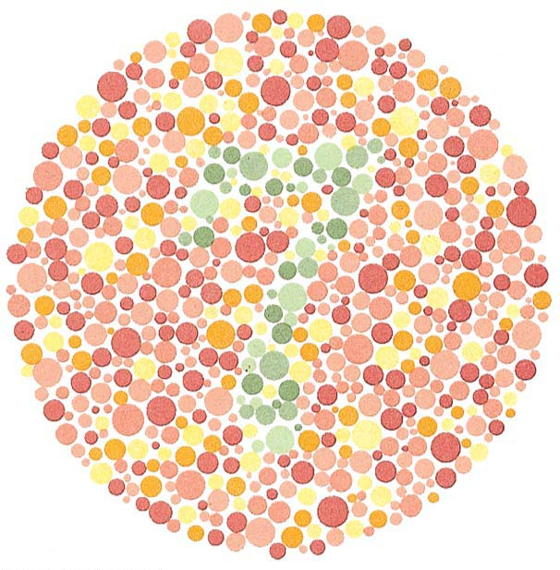
Notes:
Figure 9.26 A test for red-green colorblindness

Slide 102
Sex-Linked Genes
Because they are located on the sex chromosomes, sex-linked genes exhibit unusual inheritance patterns.
Figure 9.27a illustrates what happens when a colorblind male has offspring with a homozygous female with normal color vision.
Figure 9.27b illustrates what happens if a female carrier mates with a male who has normal color vision.
Because the colorblindness allele is recessive, a female will be colorblind only if she receives that allele on both X chromosomes.
Notes:
102

Slide 103
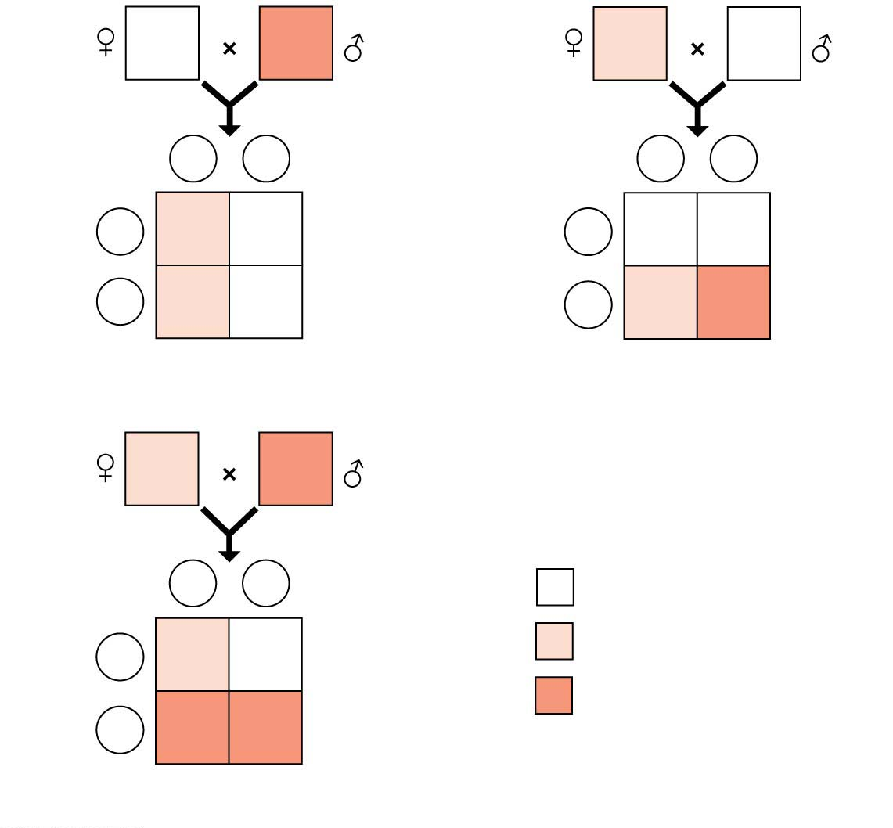
Figure 9.27
X^{N}X^{N}
X^{n}Y
X^{N}X^{n}
X^{N}Y
X^{n}
Y
Sperm
X^{N}
Y
Sperm
Eggs
X^{N}
X^{N}X^{n}
X^{N}Y
Eggs
X^{N}
X^{N}X^{N}
X^{N}Y
X^{N}
X^{N}X^{n}
X^{N}Y
X^{n}
X^{N}X^{n}
X^{n}Y
(a) Normal female × colorblind male
(b) Carrier female × normal male
X^{N}X^{n}
X^{n}Y
Key
X^{n}
Y
Sperm
Unaffected individual
X^{N}
X^{N}X^{n}
X^{N}Y
Carrier
Eggs
Colorblind individual
X^{n}
X^{n}X^{n}
X^{n}Y
(c) Carrier female × colorblind male
Notes:
Figure 9.27 Inheritance of colorblindness, a sex-linked recessive trait

Slide 104
Sex-Linked Genes
Hemophilia（血友病） is a sex-linked recessive trait with a long, well-documented history.
Hemophiliacs bleed excessively when injured because they have inherited an abnormal allele for a factor involved in blood clotting（血液凝结）.
The most seriously affected individuals may bleed to death after relatively minor bruises（擦伤） or cuts.
The age-old practice of strengthening international alliances by marriage effectively spread hemophilia through the royal families of several nations.
Notes:
104

